Slide 1

I/O Device Virtualization in the multi-core era, a QoS Perspective.
CADlab
SERC, IISc
Bangalore-12, India.
Notes:
Good Afternoon!
My name is J. Lakshmi
I work at the Supercomputer Education and Research Center in the Indian Institute of Science at Bangalore, India.
Today, in this talk, I will describe our work with regard to I/O Device virtualization architecture for multi-core systems, with a perspective on application Quality of Service.

Slide 2
Outline
Motivation
Issues with I/O Device Virtualization in the context of multi-core systems.
Existing solutions – PCI-SIG IOV
Proposed Architecture for I/O Device (NIC) Virtualization
Workflow of network communication using proposed architecture
Architecture Evaluation using Layered Queuing Network Models
Ongoing work and Future plans
Conclusion
Notes:
The outline of the talk is as follows:
First, I will introduce the motivation for this work, followed by the issues with the existing architectures of I/O Device virtualization, specifically in the context of multi-core systems. Then I will highlight the latest initiative towards I/O Device Virtualization by the PCI-SIG group bringing out the limitations that need to be fulfilled ,particularly while consolidating enterprise workloads onto multi-core systems. I will then describe the proposed I/O device virtualization architecture taking the Network Interface card as the example. Then, I will show you the workflow of network communication using the proposed architecture followed by the architecture evaluation using Layered Queuing Network Models. After which I will give you a brief on the ongoing work and then conclude.

Slide 3
Motivation
In consolidated multi-core virtualized servers, there is abundance of processors when compared to I/O devices.
While consolidating Enterprise Workloads, this leads to many virtual machines sharing a single I/O device.
In non-virtualized servers itself, the serialization of I/O device access has high service time which disallows complete device utilization while sharing.
Virtualization adds latency to this access path because of one more layer of redirection.
Notes:
The current design trend of multi-core systems is focused to support compute workloads, wherein I/O device access is well-structured. Usually in such workloads the multiple tasks are a part of a single job and all the I/O requirement of the job is handled typically by a single task. Hence, having high processor density within a system is beneficial to such workloads. In contrast, in the case of enterprise workloads, the use of higher number of processors in the system is targeted by consolidating many independent jobs on the server. In such a scenario, a single I/O device would then be shared across many independent jobs. This leads to higher contention. Virtualization technologies of today allow for higher consolidation of workloads targeting CPU utilization. The I/O device virtualization is still evolving to efficiently handle sharing among independent virtual machines. This work involves the study of prevalent I/O virtualization techniques and proposes a design extension to I/O Device Virtualization architecture with a view to support application QoS.

Slide 4
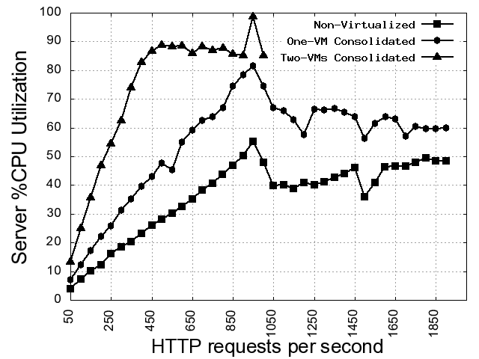
Issues with I/O Device Virtualization
Notes:
To highlight the issues with existing I/O Device Virtualization architectures I will show you a couple of graphs for the httperf benchmark, which is taken as the representative benchmark for enterprise workloads.
The graph in this slide gives details of server cpu-time required to service a given rate of http requests.
The X-axis is for http request rate, while the Y-axis shows the corresponding server CPU utilization.
The comparison is for CPU-utilization on a non-virtualized, virtualized and virtualized consolidated server.
When compared to the non-virtualized server, the virtualized and consolidated virtualized servers report higher cpu-time requirement to service the same request rate.
This is because of the virtualization overhead. Every I/O request on a virtualized server incurs some CPU utilization, which is over and above the CPU-utilization for handling the application workload.
This is in general true for I/O based workloads. Refer paper for details on the results for different benchmarks.

Slide 5
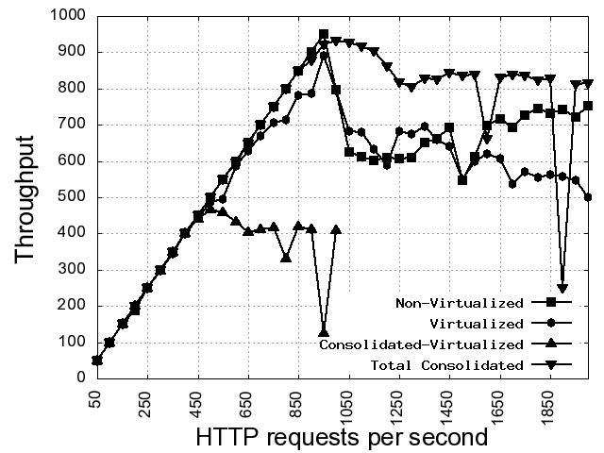
Issues with I/O Device Virtualization
Notes:
This next graph depicts the effect of virtualization on application throughput.
Here the X-axis remains the same, the Y-axis now depicts the achievable sustained application throughput.
The comparison here is for the application throughput achieved for non-virtualized, virtualized and consolidated virtualized server.
As can be seen from the graph, the sustained application throughput drops quite dramatically when the server is hosted on a virtualized server when compared to the non-virtualized server.
This is because of the increase in service time for handling I/O request on the virtualized server.
The side-effect of this increase in service time is loss of utilized I/O bandwidth on the virtualized server.
The graph also shows that by consolidation, the total bandwidth utilization across all the consolidated servers increases, which is encouraging and justifies the consolidation effort.
The flip side is that, to support same amount of bandwidth utilization on the virtualized server one would need to provide a high-speed and high-bandwidth I/O channel.
This calls for a relook at how I/O virtualization is achieved and hence this study.

Slide 6
Existing solutions – PCI-SIG IOV
PCI Special Interest Group released a I/O Virtualization specification in June 2008.
Make I/O Devices Virtualization aware and allow native access to virtual device interfaces by using
  I/O Page Tables
  Virtual Device Identifiers
  Virtual device specific interrupts
Notes:
The latest initiative on I/O device virtualization is the IO-Virtualization specification released in June 2008 by the PCI-SIG group.
The IOV specification realizes the need for making the I/O devices virtualization aware instead of supporting virtualization purely by emulation or software interfaces.
The IOV specification proposes three constructs for I/O device virtualization,
I/O Page tables: By having I/O Page Tables, the address translation between the I/O device address space to the Virtual Machine address space is direct. Because of this the VMM no longer needs to handle the address translation for each and every I/O request.
Virtual Device Identifiers: Having Virtual device Identifiers built into the hardware of the I/O device enables direct mapping of the virtual device to a virtual machine. This enables the VMM to avoid mapping of the virtual to physical device and arbitrating the device access by each virtual machine.
Virtual Device specific Interrupts: Each virtual device is identified with its own interrupt. This enables the VMM to identify the target VM based on the interrupt and reduces the overhead of analyzing each request.
PCI-SIG IOV specification allows for direct device access to the virtual machine. For a single device being shared by multiple virtual machines, the sharing still has to be arbitrated by the VMM i.e. in software. Also, to establish device partitions for sharing, the current specification does not have any provisions. Hence, we propose an extension to the IOV architecture specification to overcome these limitations.

Slide 7
Existing solutions – what is desirable?
PCI-SIG IOV talks about making device virtualization aware.
The onus is still on the VMM/IDD to control and co-ordinate device access.
As with the existing and also the IOV compliant I/O devices traffic control is still at the software layer. For outgoing traffic this maybe acceptable, but for incoming traffic this causes loss of utilized bandwidth because,
  A packet that could be discarded later, is accepted by the device.
  There is no control on how the incoming traffic is handled. It still remains first com first serve which may not be sufficient or desirable on consolidated servers.

Slide 8
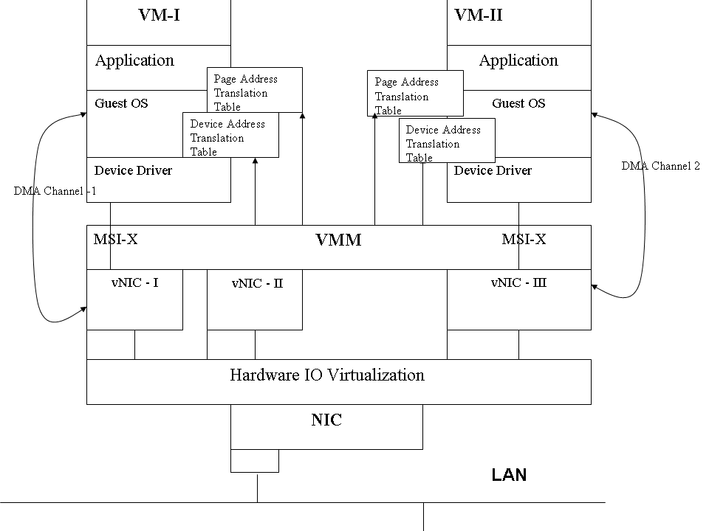
Proposed Architecture for I/O Device (NIC) Virtualization
Notes:
The picture in this slide gives a schematic diagram of the proposed NIC which supports device virtualization through partitioning. A partition of the physical device is called the virtual-NIC.
The card has a DMA controller that manages DMA transfers to and from the device. Each card supports multiple DMA channels that can be associated with individual virtual-NICs.
The device memory is now replaced by a partitionable memory supported with n sets of device registers. A set of m memory partitions, where m ≤ n, along-with device registers, forms the virtual-NIC. This device memory is expected to be dynamically reconfigurable so that the VM’s QoS requirements drives the reconfiguration.
The VMM identifies a virtual-NIC request using message signaled interrupts, i.e. each virtual-NIC is associated with its own unique interrupt.
Each virtual-NIC also has its own set of I/O page table that keeps track of the address translations between the virtual device I/O address space and the VM’s address space. This enables direct I/O device access to the VM.
The finite number of physical resources on the NIC restricts the number of Virtual-NICs that can be exported by the device. Judicious use of virtual-NICs using native or para-virtualized access allows a VM to support the desired QoS guarantees.
For native access to the virtual-NIC, the VM will host a native device driver that can only access the restricted device address space, mapped by the associated page table.
The VMM only routes the virtual-interrupt to the appropriate VM.

Slide 9
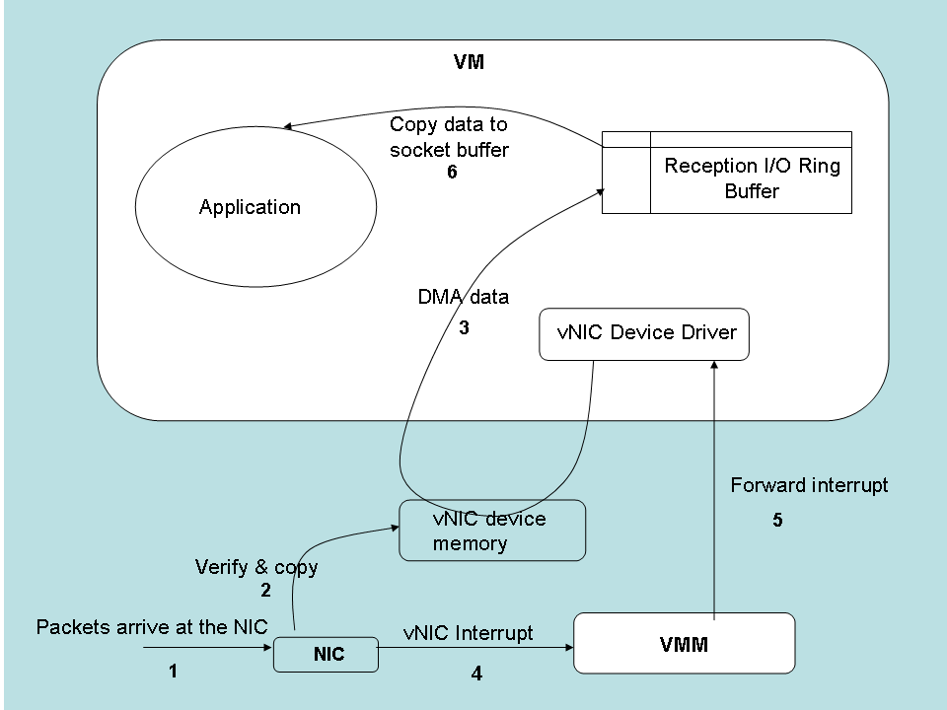
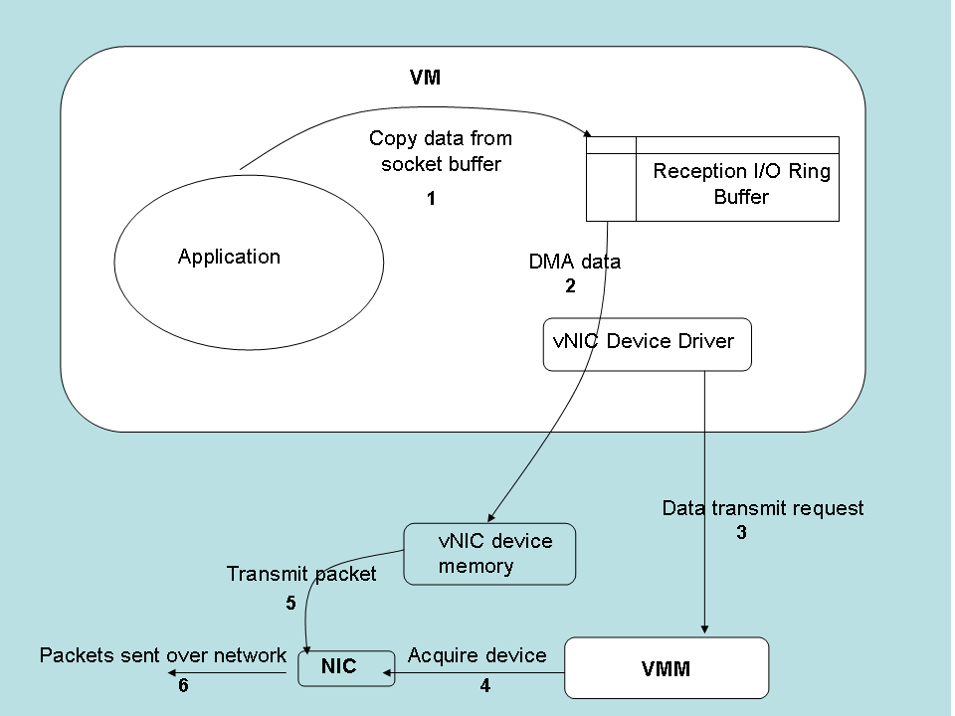
Workflow of network communication
N/w Packet Reception Workflow
N/w Packet Transmission Workflow
Notes:
In order to understand the benefits of the architecture, we use Layered Queuing Network (LQN) models to evaluate it. To generate the LQN models, we use the workflow of network packet communication in the proposed architecture.
The pictures in this slide depict this workflow, both for the reception and transmission of the packet.
For packet reception, when a packet arrives at the interface, the control logic of the card identifies the packet based on the virtual-NIC identifier, checks if the virtual-NIC has the spare bandwidth to accept the incoming packet and then copies to the associated device memory of the virtual-NIC.
From the device memory, the packet is pulled by the device driver through DMA into the VM’s reception I/O ring buffer. From this buffer the OS of the VM transfers to the application address space where the application processes the packet.
The reverse of this happens in the case of transmission. The VM hosting the application transfers the packet to its I/O ring buffer. The device driver of the VM initiates the DMA to the device from where it is transmitted on to the network. The DMA to the device memory and the transmission to the network can happen at different times based on the promised bandwidth for the virtual-NIC.

Slide 10
Architecture Evaluation
We evaluate the proposed architecture for multi-core servers for the following reasons:
  consolidation ratios are expected to be higher for such systems.
  due to many VMs sharing an I/O device, device sharing issues become critical as device utilization is pushed to its limits.
Notes:
The graphs for server CPU-utilization and application throughput discussed earlier were generated on a single-core server. Although the issues cited are present even for single core servers we evaluate the proposed architecture for multi-core servers since the consolidation ratios are expected to be higher on such systems. With higher consolidation ratios, the I/O device sharing issues become critical since the device utilization is pushed to its limits.
The following two slides show the application throughput performance and server CPU-utilization for a multi-core server for the existing and proposed architecture. In each of the cases, the VMM, IDD and the VMs are pinned to an independent core.

Slide 11
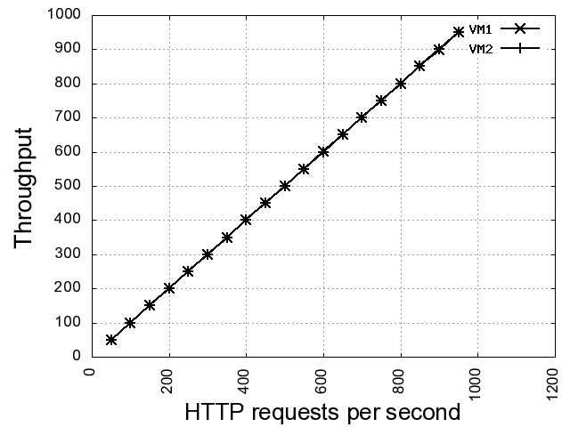
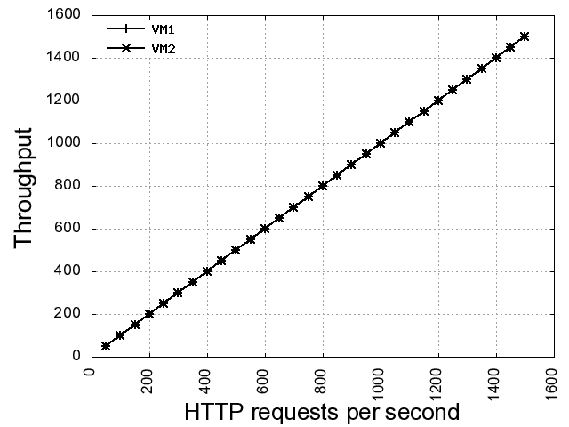
Architecture Evaluation
Max. Achievable Throughput on existing Xen architecture with each VM pinned to an independent core.
Max. Achievable Throughput on Proposed architecture with each VM pinned to an independent core.
Notes:
This slide shows two graphs. Each graph is a plot of achievable throughput against the httperf request rate.
The first graph, to your left gives the achievable maximum sustainable throughput, on the existing Xen (3.0.3) architecture, by a VM that is pinned to an independent core on a consolidated server. Throughput achieved is 950.
The right side graph depicts the same comparison for the proposed architecture. As shown in this graph, the maximum throughput achievable is 1500, which is an increase of about 60% in sustainable application throughput.

Slide 12
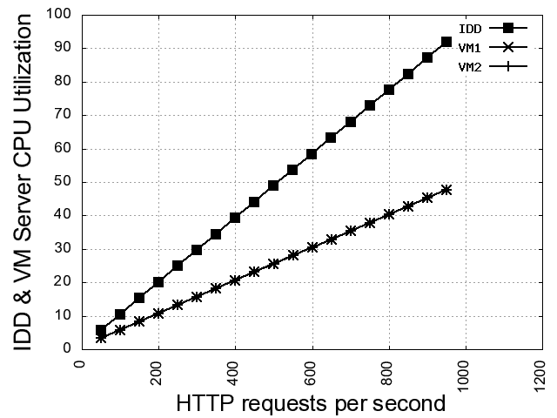
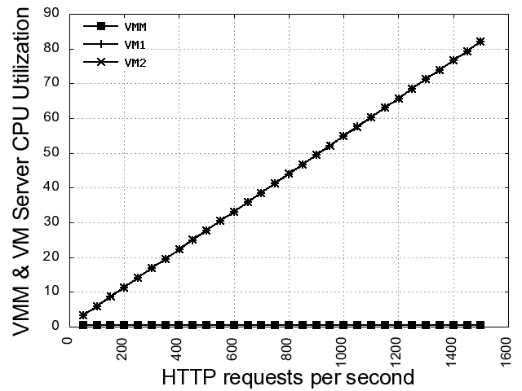
Architecture Evaluation
%CPU Utilisation for existing Xen Architecture with each VM and the IDD pinned to independent cores.
%CPU Utilisation for Proposed Architecture with each VM and the IDD pinned to independent cores.
Notes:
This slide shows the statistics on the server CPU utilization.
In the existing Xen architecture, for every I/O request, the server CPU utilization includes the utilization by the Virtual Machine and the Driver Domain hosting the NIC. This causes limitations on the device sharing scalability since Driver Domain serialization also occurs while sharing the I/O Device.
In the proposed architecture, this limitation is eliminated as can be seen in the second graph. The total server CPU utilization by the Driver Domain is reduced to minimal usage. This increases the number of VMs sharing the NIC since now the Driver Domain CPU requirement can be easily met.

Slide 13
Ongoing work and Future plans
As of this paper the basic architecture evaluation was completed and the results are encouraging.
The proposed architecture exhibits the property of scalability for I/O device sharing.
Currently, study of using reconfigurable device partitions for generating virtual device interfaces is underway. This study is to establish the effectiveness of device level QoS hooks on the achievable application throughput.
Notes:
As of this paper the basic architecture evaluation has been completed and as you have observed the results are encouraging.
The proposed architecture exhibits the property of scalability for I/O device sharing.
As of now, we are in the final stages of evaluating the effect on application QoS using reconfigurable device partitions.

Slide 14
Conclusion
In this paper we have illustrated the problems with I/O Device virtualization wherein the I/O devices are unaware that they are being virtualized.
We proposed an extension to the PCI-SIG IOV architecture with a view to support device level QoS hooks.
We demonstrated the initial results of the proposed architecture evaluation to be encouraging.

Slide 15
I welcome your questions.
Please mailto: jlakshmi@serc.iisc.ernet.in
Thankyou!

