Slide 1
Is Virtualization ready for End-to-End Application Performance?
J. Lakshmi
CADlab, SERC
Indian Institute of Science
Notes:
Primary goal of virtualization is making efficient use of available system resources. Towards this, workload consolidation using multi-core servers has been the most successful examples of green initiatives of data centers.
Knowing that virtualization is here to stay, we explore the support for end-to-end application performance on virtualized servers.
Major efforts towards workload consolidation have concentrated on aggregating CPU cycle requirements of the target workloads. On a virtualized server with limited number of I/O devices, consolidation of I/O workloads leads to sharing of the devices and their associated access paths, among independent threads. This leads to performance interference which is dependent on the nature of the consolidated workloads that share the device. The result is non-deterministic application performance on the consolidated virtualized server.
To assure performance in such scenarios it is essential to have appropriate mechanisms to define, monitor and ensure resource sharing policies across the various contending workloads.
This study is about NIC sharing and QoS support for it in prevalent virtualization technologies.

Slide 2
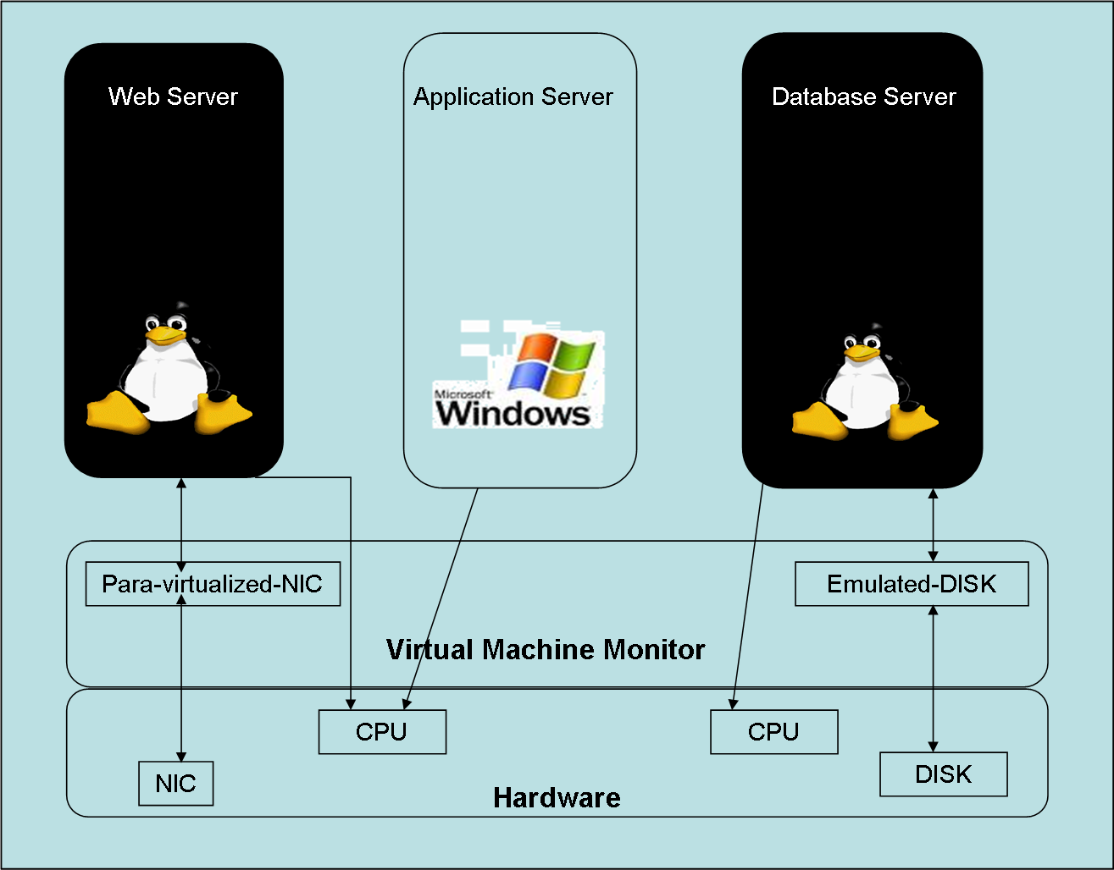
Virtual Machine
Efficient, isolated replica of the computing system.
Notes:
Setting the context, here is a schematic diagram of a consolidated virtualized server showing details of how system resources are shared. Prevalent commodity systems based virtualization technologies use different techniques like para-virtualization and device emulation to support virtual I/O devices. Approach in these systems has been to build over existing operating systems that were designed for single-hardware single-OS model.
By definition a Virtual Machine is an efficient, isolated replica of the computing system hosting it. As far as I/O virtualization is concerned, current technologies fall short of this definition.

Slide 3
Virtualized Server
Desirable properties [Goldberg (1974)] :
  System Hygiene: Hardware support for virtualization.
  Software simplicity: Smaller and simpler VMM kernel for higher security and reliability.
  System Performance: VM should be as efficient as the non-virtualized machine, if not more!
Notes:
Before we dwell into the I/O virtualization architectures, it is interesting to know what was proposed by Goldberg more than 3 decades back. In his classic survey paper on the then virtualization architectures, Goldberg noted three desirable properties for virtualized servers. These were system hygiene, simplicity and performance. Under system hygiene he commented that simulation or trap methods of virtualizing were not preferred. Instead hardware should support virtualization. This would lead to simpler, secure and reliable VMMs. He also stated that virtual machines should perform equally or better than the native systems!

Slide 4
Architectural support for Virtualization
f - map
Virtual Resource
Physical Resource
f-map
  Transforms virtual resource to real resource
  Transparent to all software
  Only VMM initializes and setups the f-maps and is given control on f-map violation.
  Privileged/non-privileged mode of operation is independent of virtualization.
Notes:
In his paper Goldberg had proposed a hardware virtualizer that allows for the following:
Defines the set of physical resources for which associated virtual resources can be defined.
The virtualizer also defines a map, called the f-map, that transforms the virtual resource to physical resource and is invisible to all software.
The VMM managing the physical resources manipulates and controls the f-maps and is given control when f-map violation occurs.
Any other structure, like the privileged/non-privileged mode of operation, is independent of virtualization and operate as it would on original machine.

Slide 5
Processor Virtualization
Virtual CPU mapping to Physical CPU fulfils the f-map definition of processor virtualization.
  A VM is abstracted as a process inside the VMM and VCPU allocated to the VM is realized using time-sharing on a physical CPU.
  Single-cores or Multi-cores support complete process context in the hardware.
Processor virtualization technologies today offer application performance close to non-virtualized servers.
Notes:
Most operating systems are process centric and system architecture is designed to benefit this model. Complete process context is supported in the hardware and using appropriate scheduling policies virtual CPU to physical CPU mapping is established without any severe performance loss.

Slide 6
I/O Device Virtualization
I/O device hardware is built to support single-OS single-device model.
Use of software layers within VMM or Driver Domains to multiplex access from device sharing VMs.
Imposes severe virtualization overheads on application performance.
  Loss of usable device bandwidth
  Loss of application throughput
Current QoS controls are also built into the software layers controlling the device which leads to inflexible sharing.
Notes:
I/O device hardware is transparent to the access control and management of data transfers. This functionality is managed by the OS of the system. This model of single-OS single hardware imposes high virtualization overheads because the virtual device and its interface is achieved through software. These overheads manifest as loss of usable device bandwidth for the virtual machine and as loss of throughput for the application. Also, in this model device sharing policies and management is through the software layers the granularity of control is coarse and inflexible to allow scalability of sharing.
What is really needed is availability of complete device bandwidth that can be flexibly shared across all the contending VMs.

Slide 7
Performance on Prevalent Technologies
(Xen and Vmware)
Benchmark: httperf
Shared Device: NIC
Metric: Throughput
Evaluation:
  Achievable throughput on virtualized server
  Achievable throughput using existing QoS controls on a consolidated server.

Slide 8
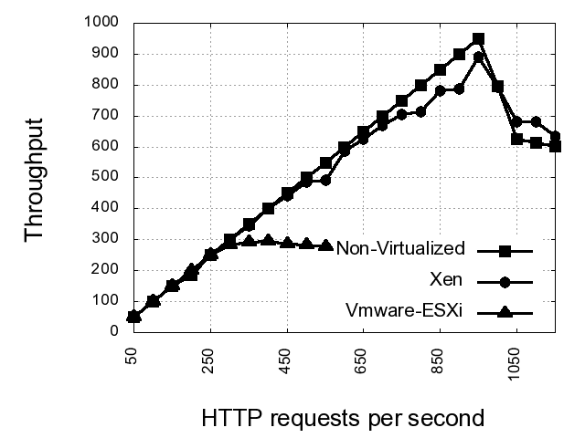
httperf throughput

Slide 9
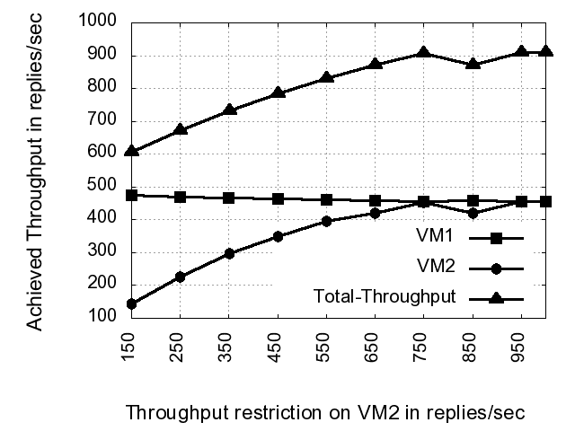
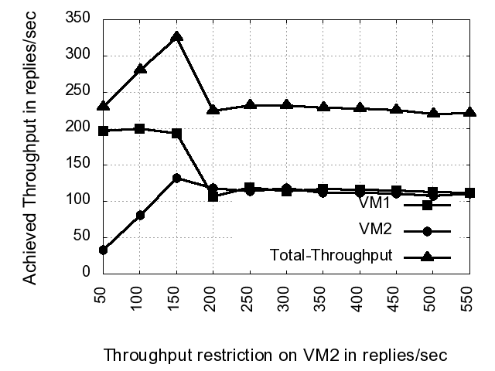
httperf throughput with QoS controls.
Linux – tc based QoS controls in XenIDD
Veam network QoS controls in VmwareESXi
Max Tput (NV): 950 replies/sec
Max Tput/VM (V): 900 replies/sec
Max Tput/VM (cons): 500 replies/sec
Max Tput (NV): 950 replies/sec
Max Tput/VM (V): 300 replies/sec
Max Tput/VM (cons): 200 replies/sec

Slide 10
Benchmark Performance Analysis
NIC virtualization not scalable.
Virtualization overheads are high enough to cause usable bandwidth loss per VM.
QoS controls insufficient to impose application specific guarantees. Existing constructs support QoS only on the outgoing stream from the server. Lack of control on the incoming stream at the device effects bandwidth availability and application throughput.

Slide 11
Missing links
I/O Devices need to be virtualization aware
  Requires micro-architecture modification to support sharing among multiple VMs.
Device virtualization architecture should allow direct or native access to I/O device.
  VMMs need to be re-architected to support native I/O device access to VMs.
Need for QoS constructs to control sharing at the device level.
  I/O devices to support QoS directed reconfigurable physical device partitions that can be exported as virtual devices.

Slide 12
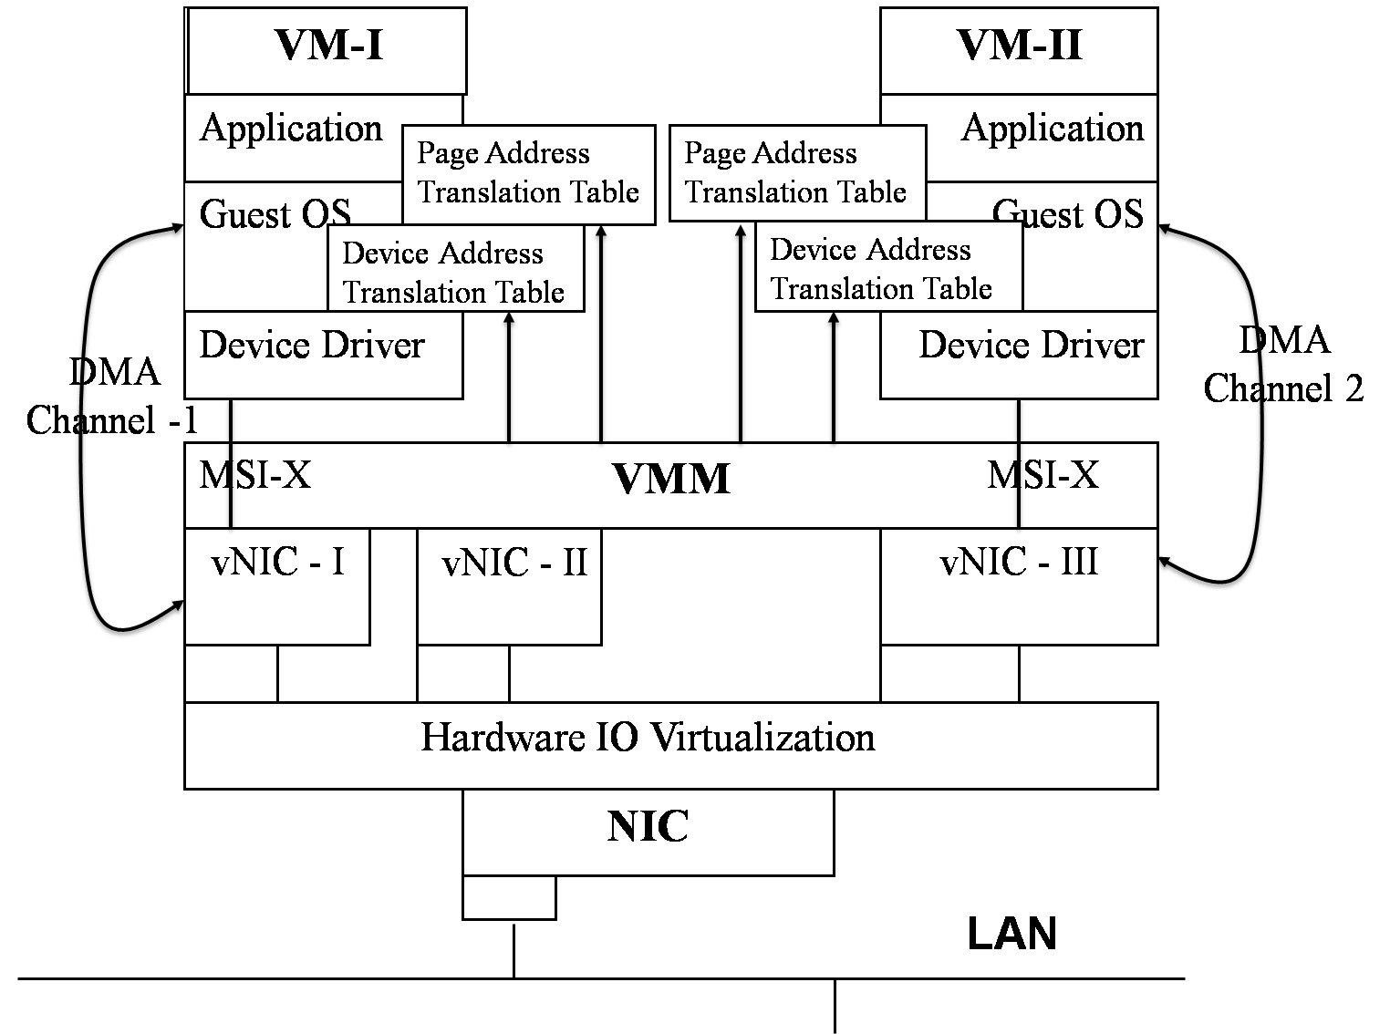
NIC Architecture Proposal

Slide 13
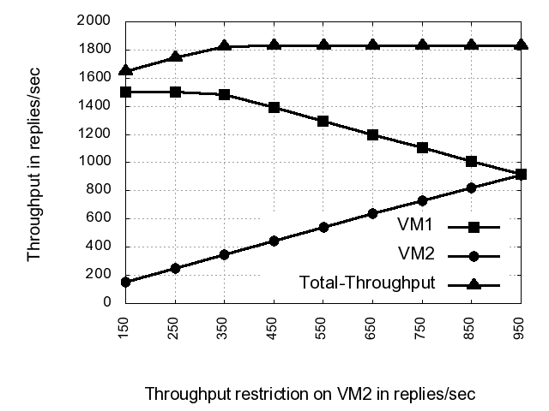
Architecture Evaluation for QoS

Slide 14
Conclusion
I/O device sharing in multi-core virtualized servers needs to support
  native device access to VMs
  device level QoS constructs, and
PCI-SIG’s IOV extended to support reconfigurable device partitions.
System virtualization architecture designed to use extended IOV devices using VMM-bypass mechanism.
Simulation of E2E architecture demonstrates required flexibility and scalability.

Slide 15
Questions?
Thankyou!

Slide 16
PCI-SIG IOV
PCI Special Interest Group released a I/O Virtualization specification in June 2008.
Make I/O Devices Virtualization aware and allow native access to virtual device interfaces by using
  I/O Page Tables
  Virtual Device Identifiers
  Virtual device specific interrupts

Slide 17
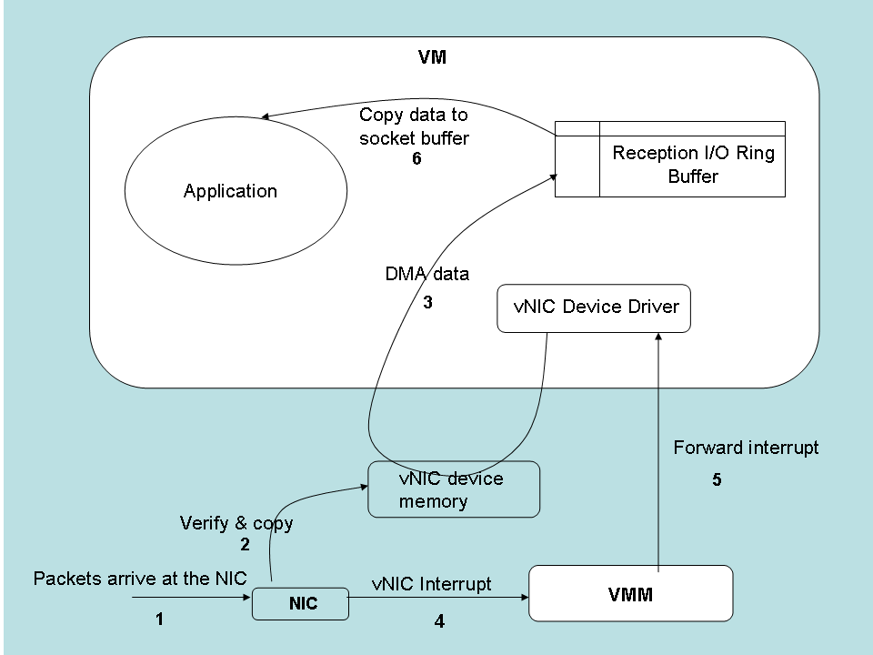
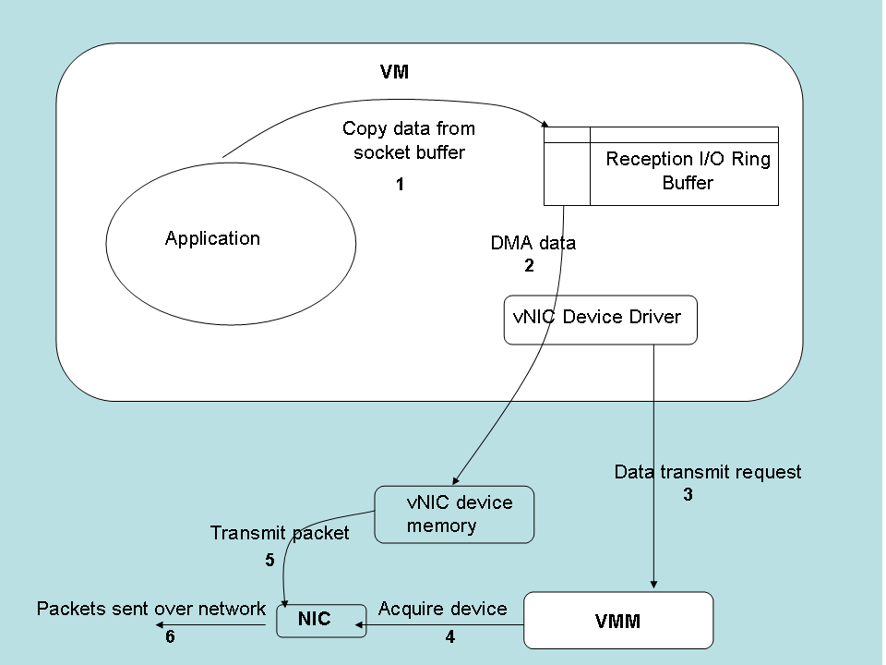
Proposed Architecture: N/W communication workflow
N/w Packet Reception Workflow
N/w Packet Transmission Workflow

