Slide 1
Productivity Tools for Scientific Computing
Python & ECLIPSE
akhilap@iisc.ac.in

Slide 2
HPC workflow
Data preparation
Data decomposition
Write a job script with appropriate parameters (nodes, cores per node)
Submit the job to the queue
Verify job run status
Analyze output – comparative analysis of multiple outputs or analysis of a single output.
Repeat!!
Automated => Easy to reproduce, reduction in errors, reduce code duplication, speed up research.

Slide 3
Why Python?
Python is probably the most versatile language for workflow management.
One of its most useful features is its ability to tie things together and automate the execution of other programs.
Free, open source with a huge set of libraries/ packages.
Python with Snakemake ( a workflow management tool) is a simple and preferred tool for automating large-scale HPC workflows.
Snakemake works cross-platform (Windows, MacOS, Linux) and is compatible with all HPC schedulers. More importantly, the same workflow will work and scale appropriately regardless of whether it’s on a laptop or cluster without modification.

Slide 4
Automating qsub using Python
template.pbs
#!/bin/sh
#This job should be redirected to idqueue
#PBS -N jobname
#PBS -l select=2:ncpus=24
#PBS -l walltime=00:02:00
#PBS -l place=scatter
#PBS -l accelerator_type="None"
#PBS -S /bin/sh@sdb -V
. /opt/modules/default/init/sh
#cd /home/proj/16/secpraba
cp /home/proj/16/secpraba/${SOURCE}.out /home/proj/16/secpraba/${WEEK}_${SOURCE}.out
aprun -j 1 -n 48 -N 24 ./${WEEK}_${SOURCE}.out ${DATA}
job_params.csv
week42,source1,data1
week43,source2,data2
week44,source3,data3

Slide 5
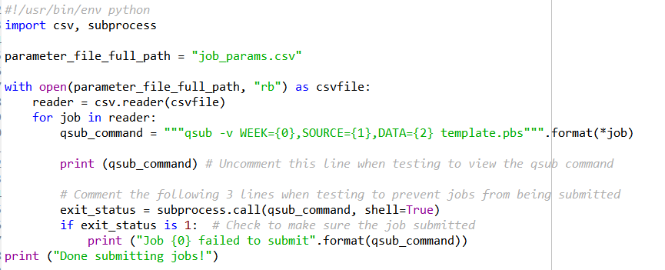
Automating qsub using Python
job_params.csv
week42,source1,data1
week43,source2,data2
week44,source3,data3
subprocess.check_output(qsub_command)

Slide 6
Automating HPC Workflow for Openfoam
Input Data File for “flow in a lid driven cavity”- {input_data_file}
Multiple runs for to test scalability for execution parameters – 50TF, 100TF, 200TF, 400TF (performance)
Preprocessing steps for each execution parameter:
Extract files using tar -zxvf {input_data_file}
change directory to {dir_name} in extracted data
run command ./{preprocess_script}
compute number of processors for each execution parameter (TF to cores on a given system)
compute coefficients for data decomposition which depends upon number of cores above
edit {decomposition_config_file} with appropriate cores and coefficients
execute {data_decomposition}
Submit multiple jobs -one for each execution parameter (TF here)

Slide 7
Automating HPC Workflow for Openfoam
YAML file with information about each execution parameter.
compute number of cores
Read YAML file
Interpret each document
Compute data
decomposition coefficients
Extract files
change directory
For each document
run preprocess.sh
edit {decomposition_config_file}
Decompose Data
Submit a job

Slide 8
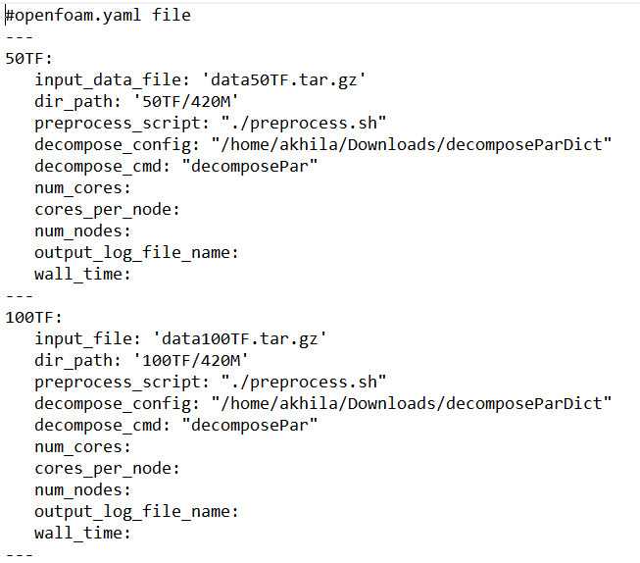
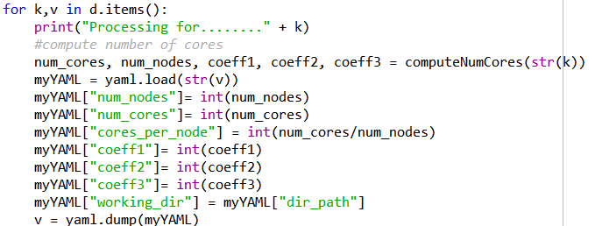
Automating HPC Workflow for Openfoam

Slide 9
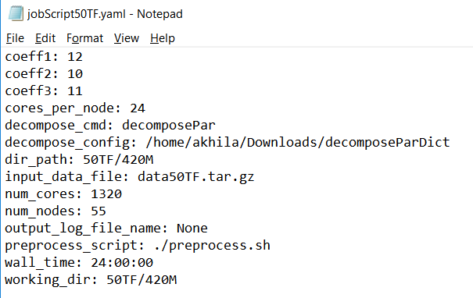
Automating HPC Workflow for Openfoam
Jobscript50TF.YAML
Create a YAML file with job parameters for each execution
Jobscript100TF.YAML
Jobscript5200TF.YAML
Jobscript400TF.YAML

Slide 10
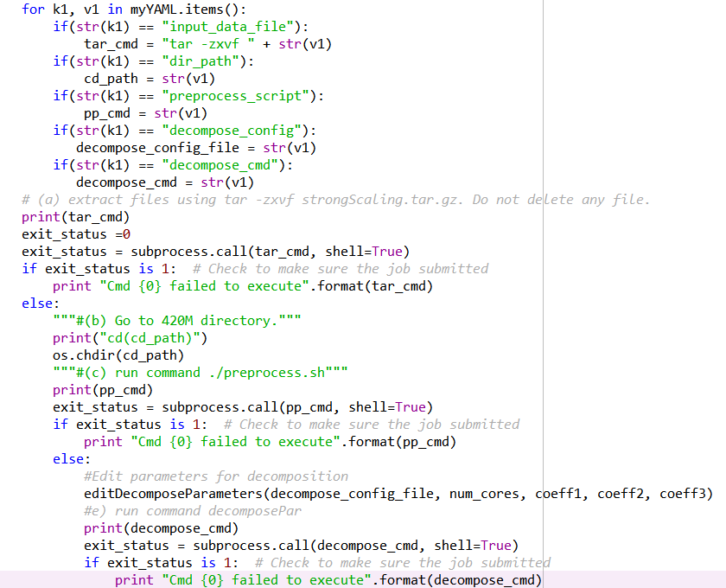
Automating HPC Workflow for Openfoam
compute number of cores
Compute data
decomposition coefficients
Extract files
change directory
run preprocess.sh
edit {decomposition_config_file}
Decompose Data
Submit a job

Slide 11
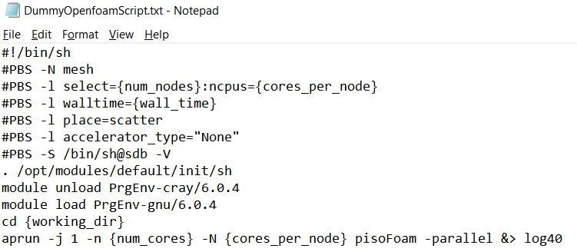
Automating HPC Workflow for Openfoam
Jobscript50TF.YAML
Jobscript100TF.YAML
Jobscript5200TF.YAML
Jobscript400TF.YAML
Python script
Jobscript50TF
Jobscript100TF
Jobscript5200TF
Jobscript400TF

Slide 12
Available Python tools & packages
atomic-hpc
snakemake

Slide 13
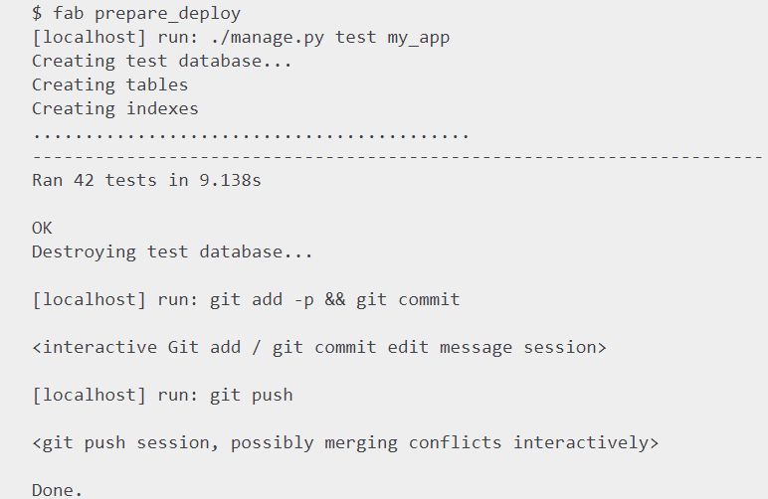
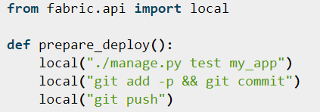
Available Python tools & packages
FABRIC/FABRIC 3.0
A tool that enables execution of arbitrary Python functions via the command line
A library of subroutines (built on top of a lower-level library) to make executing shell commands over SSH easy and Pythonic.

Slide 14
Eclipse IDE and the Parallel Tools Platform
Eclipse is an IDE (Integrated Development Environment)
It contains a base workspace and an extensible plug-in system
It can be used for app Development in Java, Ada, ABAP, C, C++, C#, Fortran, Julia, Python, PHP R, Scala, Scheme, Groovy, Erlang……
It can also be used to develop documents with Latex and packages for the software Mathematica.
Development environments include the Eclipse Java development tools (JDT) for Java and Scala, Eclipse CDT for C/C++, and Eclipse PDT for PHP, among others.

Slide 15
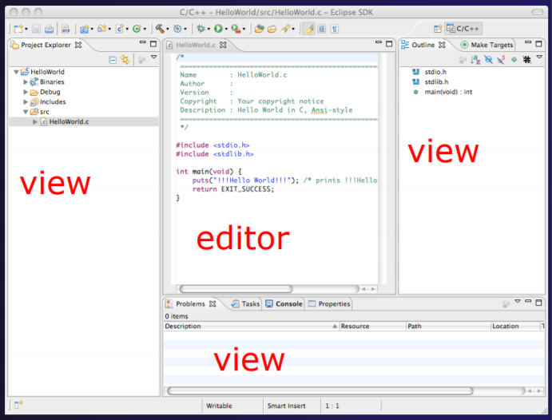
Eclipse IDE and the Parallel Tools Platform
Full development lifecycle support
Revision control integration (CVS, SVN, Git)
Project dependency management
Incremental building
Content assistance
Context sensitive help
Language sensitive searching
Multi-language support
Debugging

Slide 16
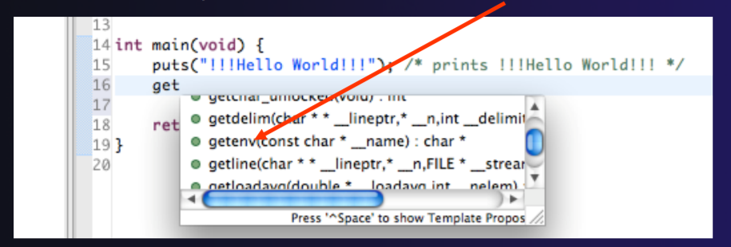
Type an incomplete function name e.g. “get” into the editor, and hit ctrl-space
Select desired completion value with cursor or mouse

Slide 17
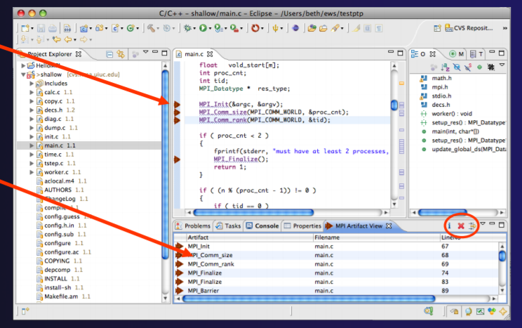
PTP’s Parallel Language Development Tools (PLDT)
Show MPI Artifacts
Code completion / Content Assist
Context Sensitive Help for MPI
Hover Help
MPI Templates in the editor
View artifacts in the View-window
MPI Barrier Analysis
PLDT has similar features for OpenMP, UPC, OpenSHMEM, OpenACC

Slide 19
MPI_BARRIER Analysis
Barrier statements, in which all tasks must synchronize, are not matched properly, may cause deadlocks.
If one MPI task in a communicator does not pass through the same number of MPI_Barrier statements as the other tasks in the same communicator, the other tasks will deadlock while waiting.
Barrier analysis checks an MPI program and determines whether there are deadlocks due to the misplacement of barriers.
It will report errors if any, and show "matching sets" for each barrier if error-free.
The matching set of a barrier contains all barriers that synchronize with it at run time.

Slide 20
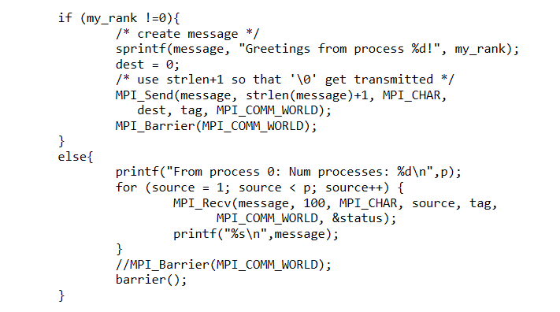
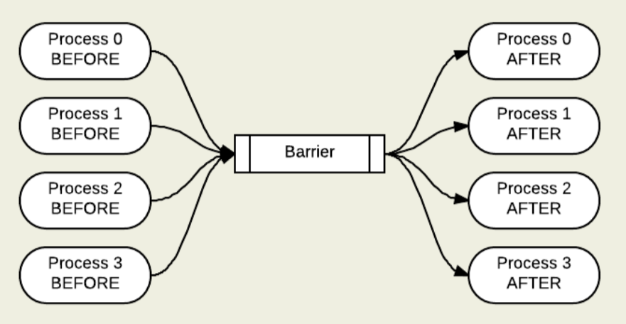

Slide 21
MPI Barrier Analysis
Verify barrier synchronization in C/MPI programs
For verified programs, lists barrier statements that synchronize together (match)
For synchronization errors, reports counter example that illustrates and explains the error

Slide 22
Automating HPC workflows
Organize Data and HPC Code into folders that align with workflow pipelines.
Versioning code using git or similar tools will increase productivity.
Use YAML that maps to the folder structure to define these workflows.
Add python scripts to translate YAML to actionable code that could range from code commits to git, preprocessing, job submission and post processing analytics.
Pre and Post processing activities are performed on DELLVS machines (different from SahasraT)- python could help tie all loose ends and enable research reproducibility.
Use of Eclipse for Scientific workflow and development.
https://www.eclipse.org/downloads/
https://www.eclipse.org/ptp/downloads.php

