Slide 1
I/O Device Virtualization for Security
CADlab
SERC, IISc
Bangalore-12, India.
Notes:
Good Afternoon!
My name is J. Lakshmi
I work at the Supercomputer Education and Research Center in the Indian Institute of Science at Bangalore, India.
All of us are aware of the resurgence of virtualization with the availability of solutions on commodity platforms. The efficacy and ease of use of these solutions has ensured widespread adoption of virtualization. However, concerns with regard to performance and security, specifically with regard to I/O devices, still remain. Today, in this talk, I will describe our work with regard to I/O Device virtualization architecture for security. The USP of this work is that device virtualization, if architected the right way, can provide simple and efficient mechanism for security.

Slide 2
Outline
Motivation
Issues with prevalent I/O Device Virtualization architectures, from the perspective of security.
What is desirable.
Proposed Architecture for I/O Device (NIC) Virtualization
Architecture Evaluation using Layered Queuing Network Models
Ongoing work and Future plans
Conclusion
Notes:
The outline of the talk is as follows:
First, I will introduce the motivation for this work, followed by the issues with the existing architectures of I/O Device virtualization, specifically in the context of security. In light of the shortcomings, I will list out what is desirable and then describe our proposal of I/O device virtualization architecture, taking the Network Interface card as the example. Later, I will present the evaluation results of the proposed architecture implemented using Layered Queuing Network Model. I will then conclude with a brief on the future work.

Slide 3
Motivation
In general purpose systems, I/O devices like the Network Interfaces and Disks have been designed to be accessed through the OS privileged kernel.
Extension of such systems (Ex. Vmware, Xen, etc.) to support virtualization leads to sharing of device access path along-with the device.
Access path sharing not only adds to access latencies, but also introduces security vulnerabilities related to
buggy device drivers of shared devices.
access to privileged memory areas through unconstrained device DMA.
denial of service attacks due to ineffective device usage controls.
Notes:
Traditionally I/O devices have been accessed through the privileged OS kernel. Extending such systems for virtualization enforces the access path to be shared for shared devices. Common examples like the emulation or hosted device virtualization mechanisms need access path sharing to share a device. This is because of software based virtualization over singly accessible hardware devices. In such systems, the device virtualization software layer becomes the vulnerable component for failure of all the VMs sharing the device. The severity of this vulnerability is more because it involves device drivers, which are cited to be the widespread cause for system failures.
Because of device access through the privileged OS kernel, devices that allow for unconstrained DMA have been exploited for writing into critical addresses of the OS kernel. This adds to the vulnerability.
Co-hosting of multiple VMs on a virtualized server is achieved by sharing the same hardware amongst the different VMs. Unconstrained and unchecked resource usage in such systems can potentially lead to denial of service attack. Device usage controls, in prevalent systems, are currently implemented high up in the virtualization stack due to which they are ineffective in providing fine control and thus can potentially lead to denial-of-service type of attacks.

Slide 4
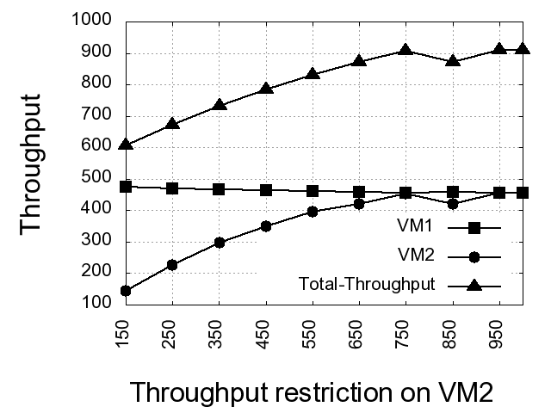
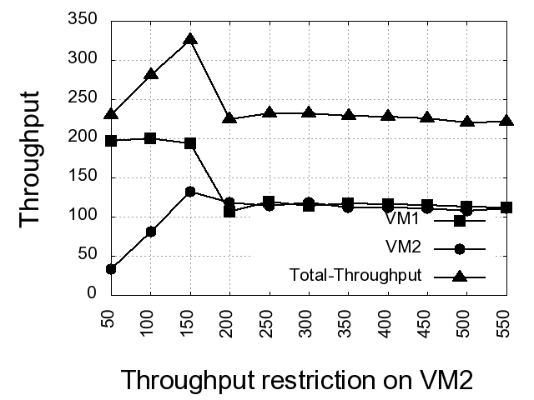
Issues with I/O Device Virtualization
Xen Hypervisor
Vmware Hypervisor
Device bandwidth throttling due to ineffective resource controls.
Notes:
Here is a slide that depicts the effect of coarse grained resource controls on device usage.
The graphs in the slide, show application throughput achieved by two different VMs sharing a NIC, on a consolidated virtualized server. VM1 is allowed to use all the available device bandwidth, while VM2 is constrained by the max. throughput that it can deliver. This throughput constraint is plotted on the x-axis. The graphs represent the performance of httperf benchmark.
Each VM is identical in configuration and supports an independent httperf client. .
In the experiment each VM is subjected to the maximum httperf load it can take on an isolated virtualized server.
In each graph, the curve for total-throughput indicates the consolidated throughput achieved on the NIC. It is interesting to observe that this curve seems to be following the curve for VM2! What is expected is a straight line.
The supposedly spare device bandwidth, due to the constraint on VM2 throughput, does not seem to be available to VM1. The reason for this is because in both cases virtualization is supported through software layer and the resource usage controls on the virtual devices is implemented in this layer. As result of which, network packets that get discarded later are accepted by the device and this causes loss of device bandwidth. This loss is visible from VM1’s throughput.

Slide 5
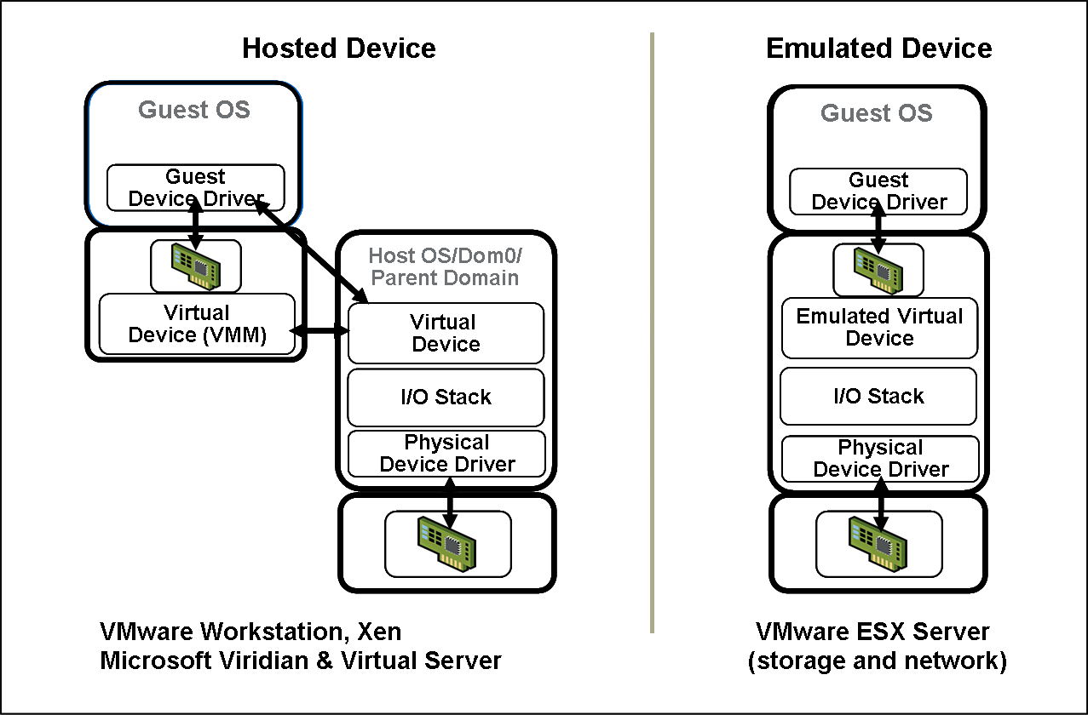
Existing solutions for I/O Device Virtualization
NIC QoS
Notes:
This picture gives you the device virtualization architecture schematic for hosted device, on the left, and emulated device, on the right, in the prevalent solutions. The NIC usage controls are provided at the layer indicated by the blue, double headed arrow.

Slide 6
Existing solutions – what is desirable?
Requirement: Virtualization leads to sharing of limited I/O devices by multiple, independent VMs. This necessitates concurrent device access.
Issues with existing solutions:
Existing solutions provide concurrency through software, which makes this layer the vulnerable link for failure of all the VMs sharing the device.
Existing virtual devices are software abstractions built in the privileged OS kernel. Thus device usage controls are built high in the software I/O virtualization stack, which renders them ineffective, leading to potential denial-of-service attacks.
Solution: If virtualization is supported by the micro-architecture of the I/O device hardware through the complete virtualization stack of the hypervisor and the GuestOS, it can provide a simple and effective solution.
Notes:
To summarize, the existing solutions are supported on single access devices, with a software layer providing the abstraction of virtual device. What we need is concurrent access to I/O devices with virtual devices supported by the micro-architecture of the hardware.

Slide 7
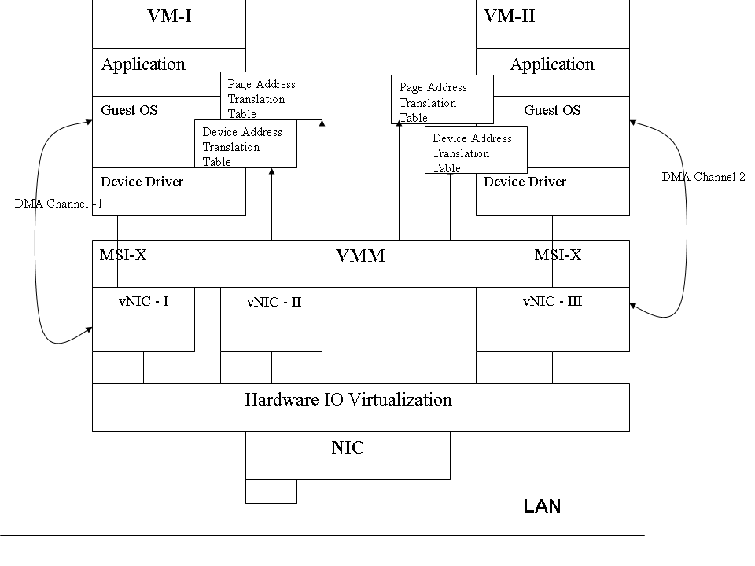
Proposed Architecture for I/O Device (NIC) Virtualization
Notes:
The picture in this slide gives a schematic diagram of the proposed NIC which supports device virtualization through partitioning. A partition of the physical device is called the virtual-NIC. The virtual-NIC allows for separation of device management from device access.
This card has a DMA controller that manages DMA transfers to and from the device. Each card supports multiple DMA channels that can be associated with individual virtual-NICs.
The VMM identifies a virtual-NIC request using message signaled interrupts, i.e. each virtual-NIC is associated with its own unique interrupt. The VMM only routes the virtual-interrupt to the appropriate VM.
The device memory is now replaced by a partitionable memory supported with n sets of device registers. A set of m memory partitions, where m ≤ n, along-with device registers, forms the virtual-NIC. This device memory is expected to be dynamically reconfigurable. The VM’s QoS requirements drive the reconfiguration. The device controller manages the partitions and their associated properties like size, priority, bandwidth, etc. This enables resource usage controls on the device.
Each virtual-NIC also has its own set of I/O page table that keeps track of the address translations between the virtual device I/O address space and the VM’s address space. This enables direct I/O device access to the VM and eliminates access path sharing and the vulnerability associated with it.
For native access to the virtual-NIC, the VM will host a native device driver that can only access the restricted device address space, mapped by the associated page table. Since the VM exists at a higher protection ring as compared to the VMM, any device driver built with unconstrained DMA will automatically trap to VMM when trying to access memory outside its address space.

Slide 8
Architecture Evaluation
Proposed architecture is implemented using Layered Queueing Network Model and evaluated using simulation studies.
(Details of the model generation and validation are available in “J.Lakshmi, S.K.Nandy, Modeling Architecture-OS interactions using Layered Queuing Network Models, International Conference Proceedings of HPC Asia:382–389, 2009.” )
Notes:
Now comes the question of evaluating the proposed architecture.
The proposed architecture involves changes to the complete end-to-end architecture of I/O device virtualization.
The hardware changes proposed for the NIC are difficult to implement on a virtualized server unless a physical prototype is available and appropriate changes are effected in the virtualization stack. This is the aim of future work.
However, we develop a layered queuing network model of the end-to-end architecture to evaluate the effectiveness of moving the resource controls onto the device and providing native device access to the GuestOS. Details of modeling and its validation are in the cited reference.

Slide 9
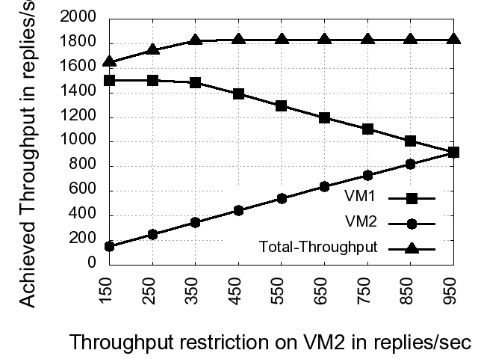
Architecture Evaluation
Improved Availability of device bandwidth with device based resource controls.
Notes:
This slide demonstrates the effectiveness of the proposed architecture.
As can be observed from the graphs, we notice that by eliminating the device access path sharing, we achieve better application throughput.
And, by enabling resource usage controls on the device we eliminate bandwidth wastage. This is reflected in the improved throughput availability for VM1 depending on the applied constraint on VM2.

Slide 10
Ongoing work and Future plans
As of this paper the basic architecture evaluation for performance and security is completed and the results are encouraging.
The proposed architecture exhibits the property of scalability for I/O device sharing.
In future, the goal is to build a physical prototype and validate the architecture.
Notes:
As of this paper the basic architecture evaluation for performance and security are completed and as you have observed, the results are encouraging.
The proposed architecture exhibits the property of scalability for I/O device sharing.
In future we intend to build the physical prototype of the NIC and integrate it with an open source hypervisor to implement the proposed end-to-end architecture.

Slide 11
Conclusion
In this paper we have highlighted some of the problems with I/O Device virtualization with regard to security issues.
We believe that virtualization inherently provides a simple and effective method for isolation, if architected correctly.
To prove the hypothesis, we used the NIC as an example and proposed end-to-end NIC virtualization architecture to address the security threats identified.
We demonstrated, using simulation results, the effectiveness of the proposed architecture.

Slide 12
Thankyou!
I welcome your questions.
Please mailto: jlakshmi@serc.iisc.ernet.in

