Slide 1
Indian Institute of Science, Bangalore
High throughput computational design of thermoelectric materials
Abhishek K. Singh
Materials Research Centre
Indian Institute of Science, Bangalore

Slide 2
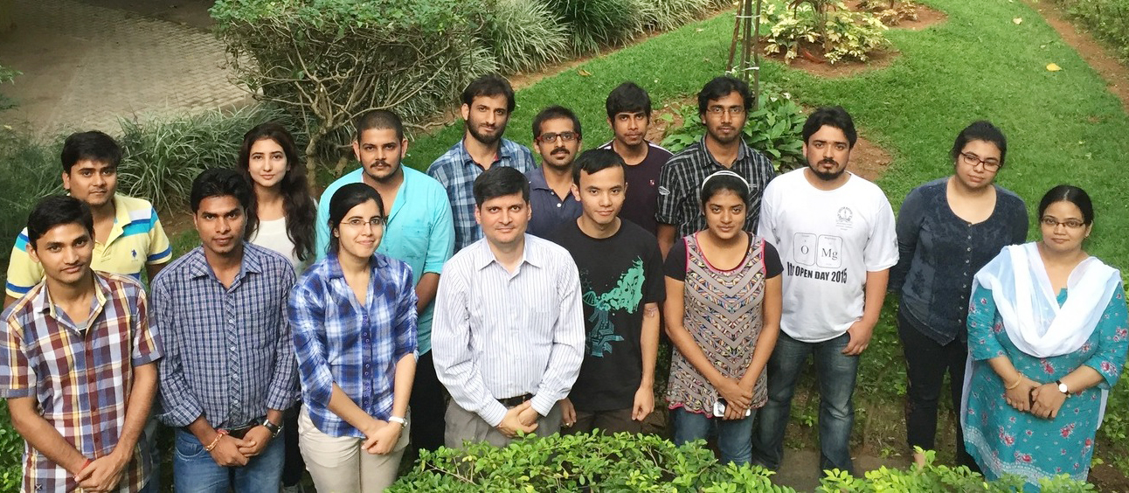
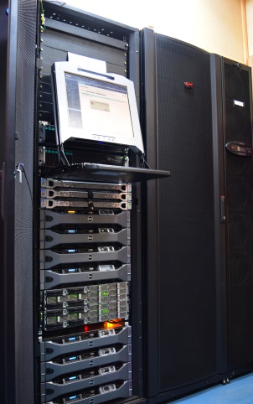
Acknowledgement
Indian Institute of Science, Bangalore
Theory and simulation group
Tribhuwan
George
Tej and Planck @MRC
Cray XC40 - "SahasraT"
SERC Team: Dr. Lakshmi, Vinod and Anup
Funding Agencies
NpMass, DST Nano Mission

Slide 3
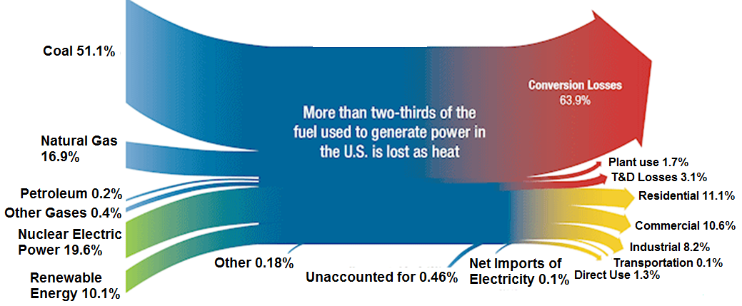
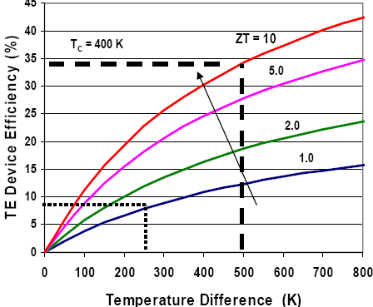
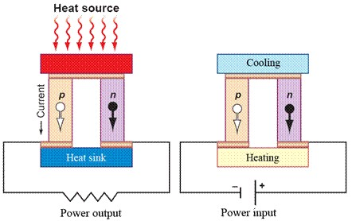
Indian Institute of Science, Bangalore
Introduction to thermoelectricity
Recover waste heat
Thermal gradient ←→ Voltage difference
Seebeck effect
Peltier effect
http://edge.rit.edu/edge/P07440/public/Home

Slide 4
Indian Institute of Science, Bangalore
Challenges in efficient thermoelectric designing
Thermopower
= dV/dT
Electrical conductivity
Large power factor (PF)
Small lattice thermal conductivity
Electronic thermal conductivity
Lattice thermal conductivity
It is relatively easy to reduce the thermal conductivity.
Increasing power factor at the same time is a challenging task.
How to identify a suitable semiconductor??

Slide 5
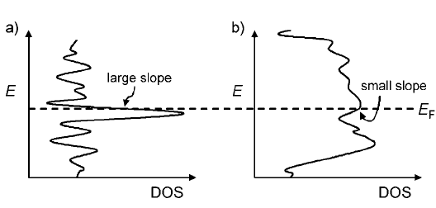
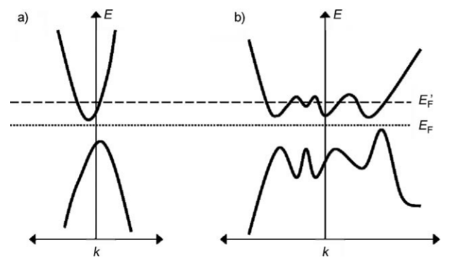
Indian Institute of Science, Bangalore
Materials selection for thermoelectric
$$\frac{dn(E)}{dE}$$
$$S=\frac{π^{2}}{3}{\frac{K_{B}}{e}K}_{B}T\left(\frac{1}{n}\frac{dn(E)}{dE}+\frac{1}{μ}\frac{dμ(E)}{dE}\right)$$
Large slope near the band edge results in high thermopower
$$PF= \sum_{γ=1}^{n}{S_{γ}^{2}σ_{γ}}$$
Higher γ leads to higher ZT
M. G. Kanatzidis et al. Angew. Chem. 48, 8616 (2009)

Slide 6
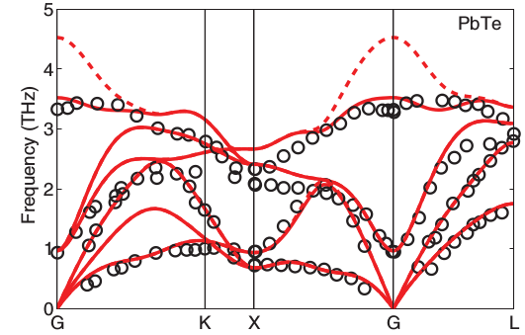
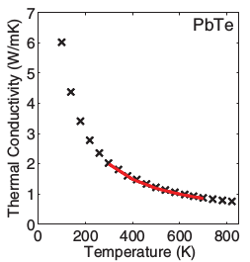
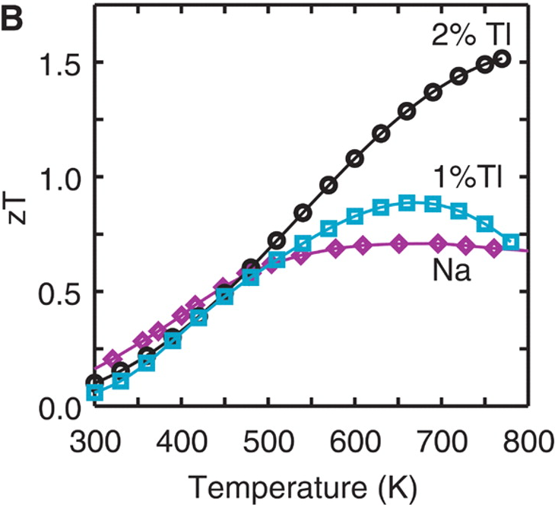
Indian Institute of Science, Bangalore
Materials with low thermal conductivity
Materials with low lying flat acoustical branches
Low group velocity
Soft lattice
However soft lattice results into low melting point
PHYSICAL REVIEW B 85, 184303 (2012)
Notes:
As shown for PbTe its peculiar electronic structure results in high thermoelectric performance. However it is not the case always hence it is necessary to optimize the thermoelectric performance..

Slide 7
Indian Institute of Science, Bangalore
Strategies for designing thermoelectric materials
Materials by “design” approach
Materials with high power factor and but low thermal conductivity
How can we scatter phonons but not electron
Phonon glass electron crystal
Breaking the inverse coupled dependence of S and σ
Special band structures, heavy light band mixtures
Tuning of carrier effective masses

Slide 8
Indian Institute of Science, Bangalore
Materials with high power factor but low thermal conductivity

Slide 9
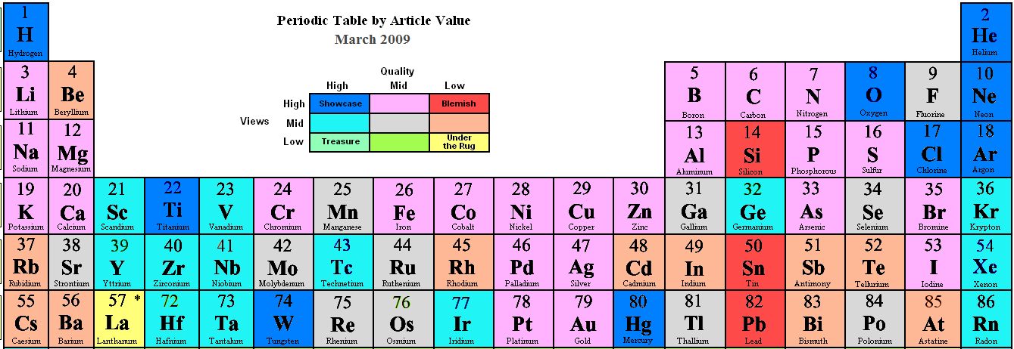
Zintl materials
Indian Institute of Science, Bangalore
“Zintl phases” stand somewhere in-between metallic and ionic compounds
An electropositive cationic component (A) (alkali metal, alkali earth metal) and anionic component (X)
Zintl-Klemm Concept
A
X
Complete charge transfer
A

Slide 10
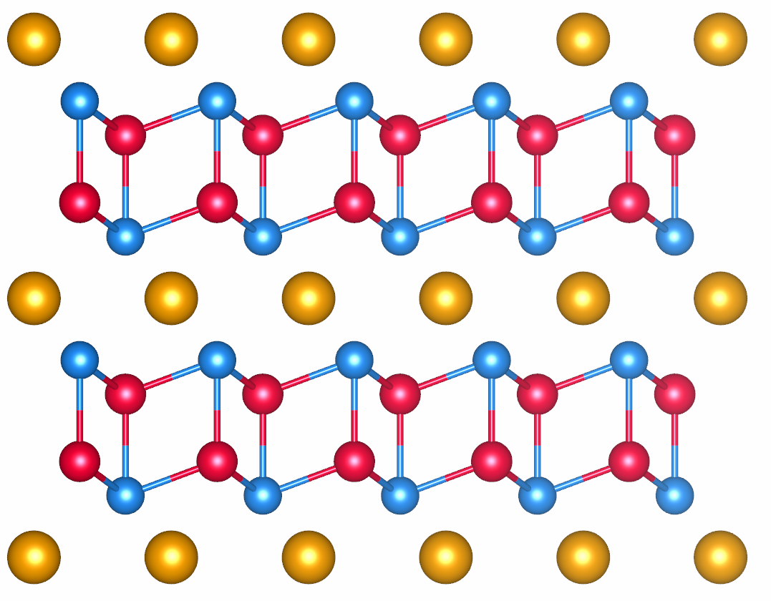
Indian Institute of Science, Bangalore
Why this buzz about Zintl materials?
Cation
layer
Anion
layer
Nature Materials 7, 105 - 114 (2008)
A²⁺ [Cd₂Sb₂]²⁻: A is electropositive and donates two electrons to the [Cd₂Sb₂] unit.
Phonon glass & electron crystal
Nature Materials 7, 105 - 114 (2008)

Slide 11
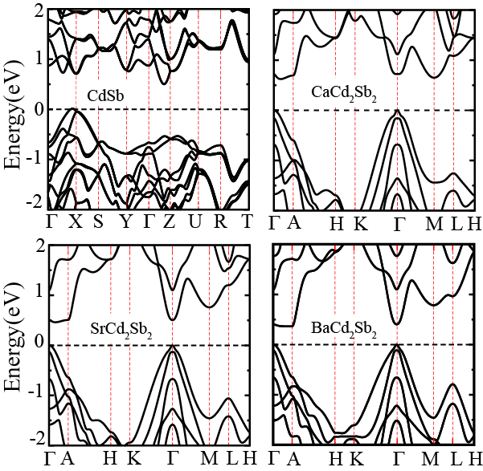
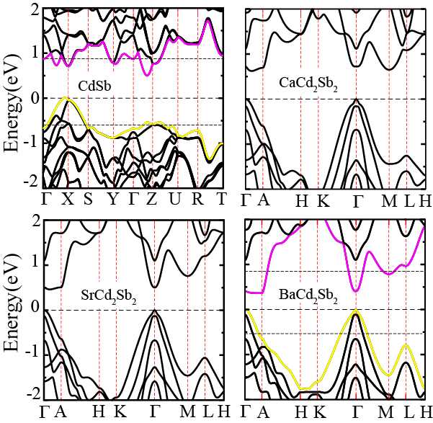
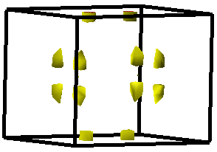
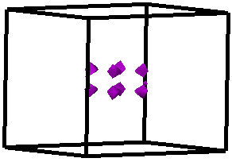
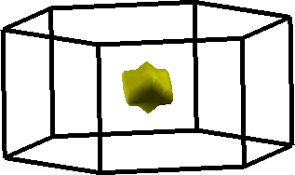
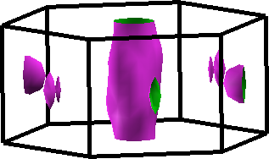
Indian Institute of Science, Bangalore
Electronic structure of Cd based Zintl compounds
VBM
CBM
System | Band gap (eV)
 | PBE | MBJ | MBJ+SOC | Exp
CdSb | 0.13 | 0.49 | 0.54 | 0.51
CaCd₂Sb₂ | 0.24 | 0.83 | 0.62 | 0.63
SrCd₂Sb₂ | Metal | 0.67 | 0.46 | x
BaCd₂Sb₂ | Metal | 0.57 | 0.37 | x
CdSb
BaCd₂Sb₂
Moderate gap semiconductor
Suggests significant anisotropy in electrical conductivity
Band structure exhibits mixed features
Phys. Chem. Chem. Phys.17, 16917 (2015)
Notes:
The combination of heavy and light band results in pipe like Fermi surface at gamma-A direction indicative of better thermoelectric performance

Slide 12
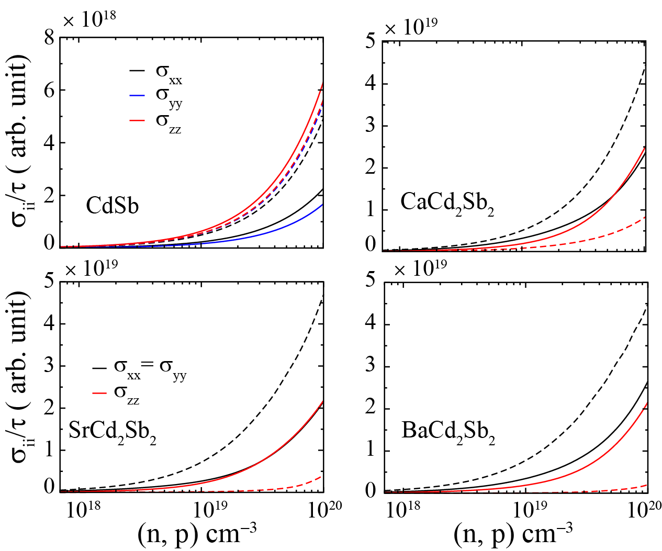
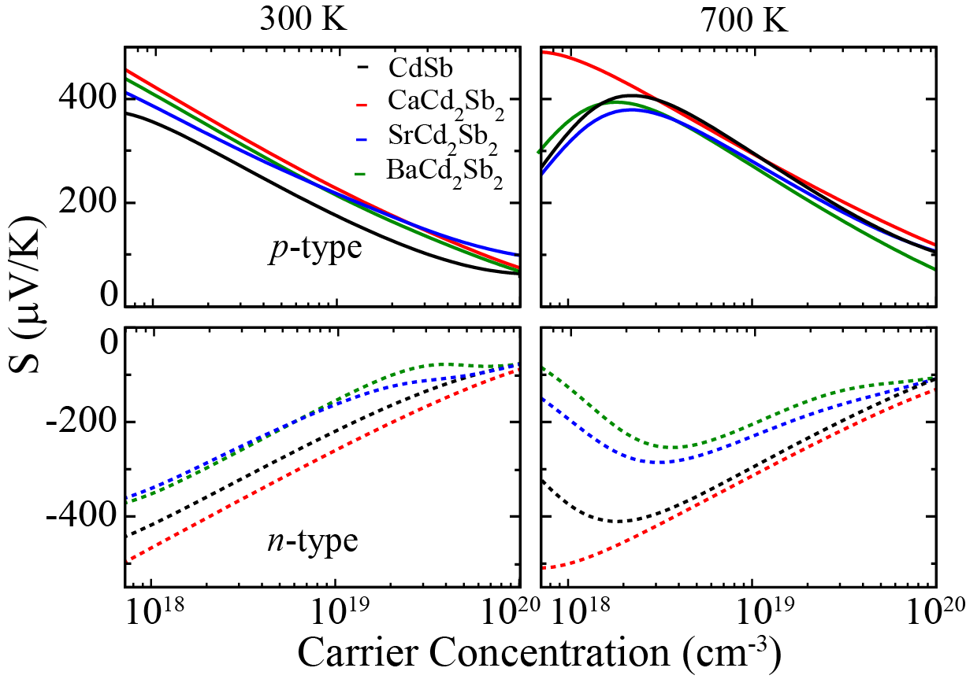
Indian Institute of Science, Bangalore
Transport properties
Huge anisotropy in electrical conductivity
Bipolar effect free large thermopower at 5 × 10¹⁸ cm⁻³ or higher carrier conc.
Phys. Chem. Chem. Phys.17, 16917 (2015)

Slide 13
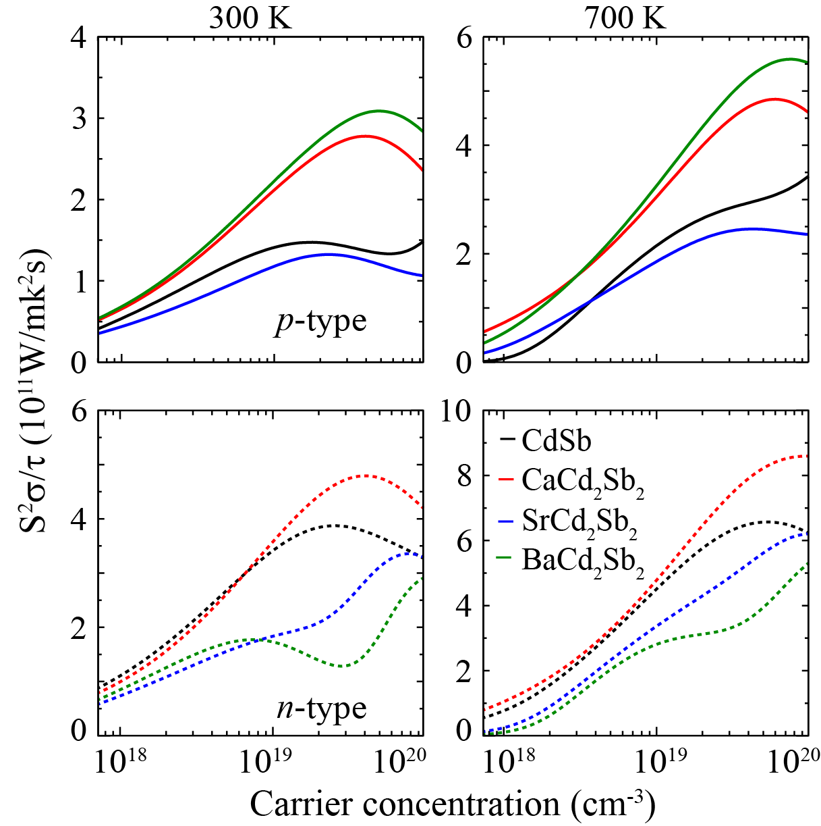
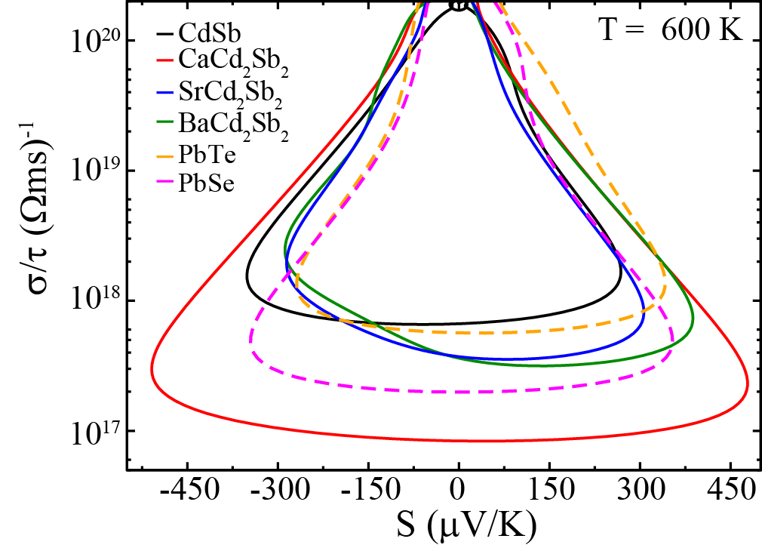
Indian Institute of Science, Bangalore
High power factor in Cd based Zintl compounds
T = 700 K
Electron crystal
Large power factor resulting from co-existing high thermopower and electrical conductivity
Phys. Chem. Chem. Phys.17, 16917 (2015)

Slide 14
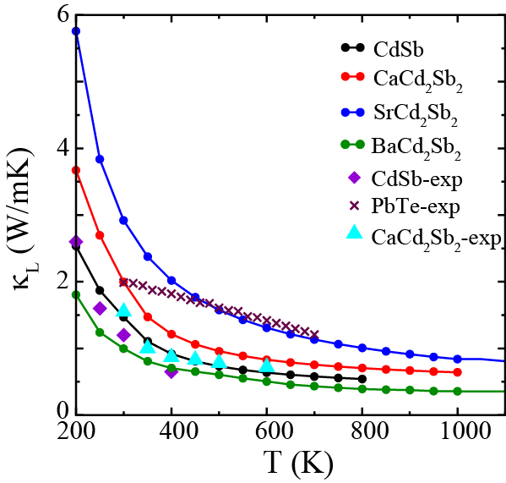
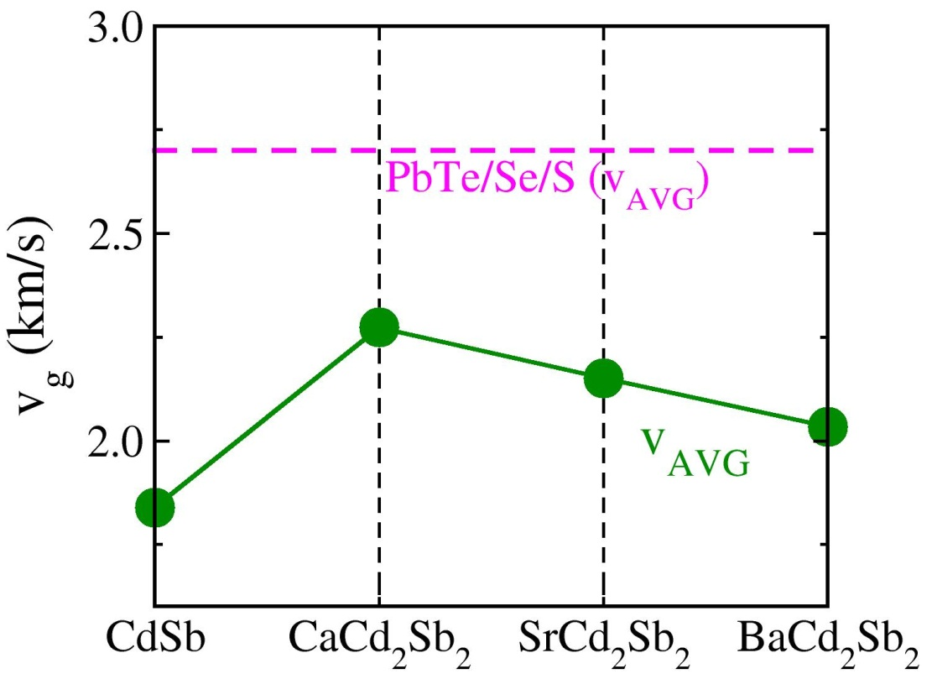
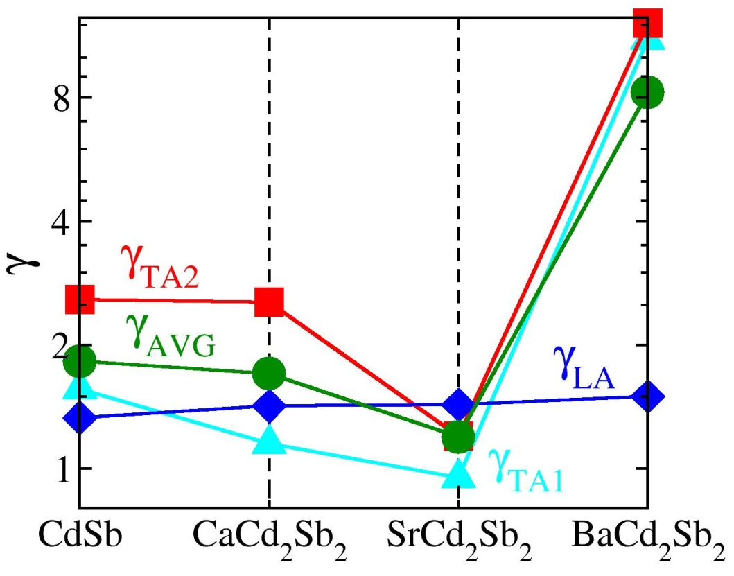
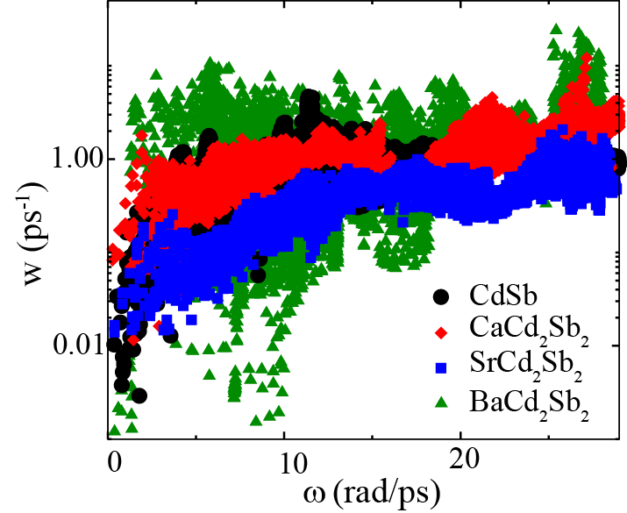
Indian Institute of Science, Bangalore
Thermal conductivity
$κ_{l}$ (W/mK)
Phonon glass
$$γ=− \frac{V}{ω}\frac{∂ω}{∂V}$$
Grüneisen parameter
Thermal conductivity less than 1W/m-K at 600K
$$κ= \sum_{λ}{C_{λ}v_{λα}v_{λβ}τ_{λβ}}$$
Large Grüneisen parameter indicate strong anharmonicity in the lattice
Ultra low thermal conductivity for BaCd₂Sb₂
Low phonon group velocity
Three phonon scattering influences the thermal conductivity most.
Phys. Chem. Chem. Phys.17, 16917 (2015)

Slide 15
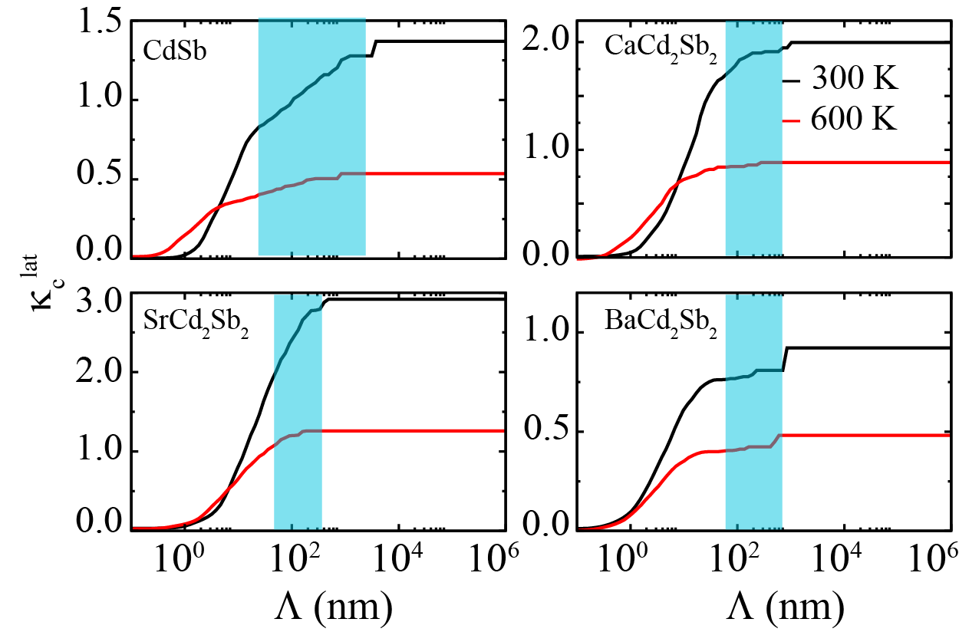
Indian Institute of Science, Bangalore
Effect of nano-structuring on thermal conductivity
By reducing grain size thermal conductivity can be reduced by 30 %
Grain Size 100-5000 nm for CdSb and 100-1000 nm for ACd₂Sb₂
Phys. Chem. Chem. Phys.17, 16917 (2015)

Slide 16
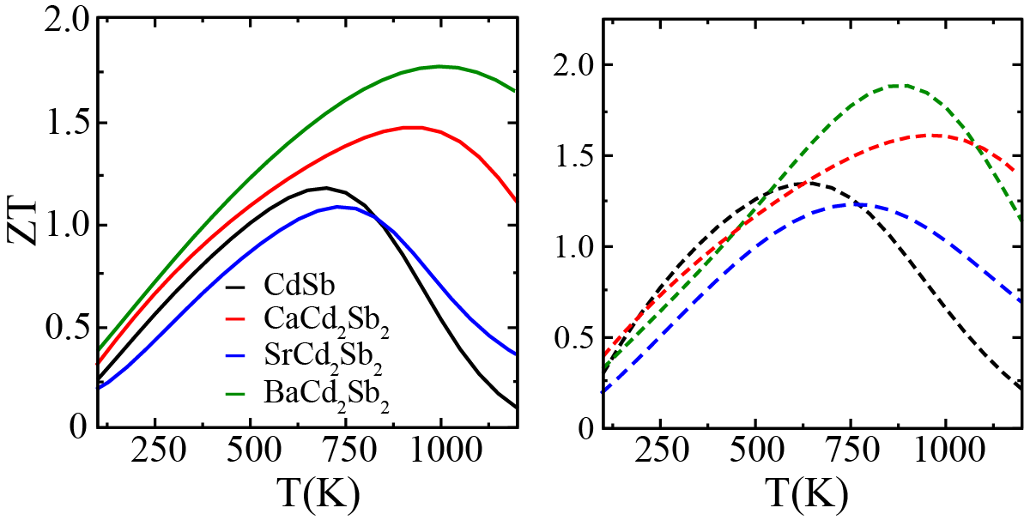
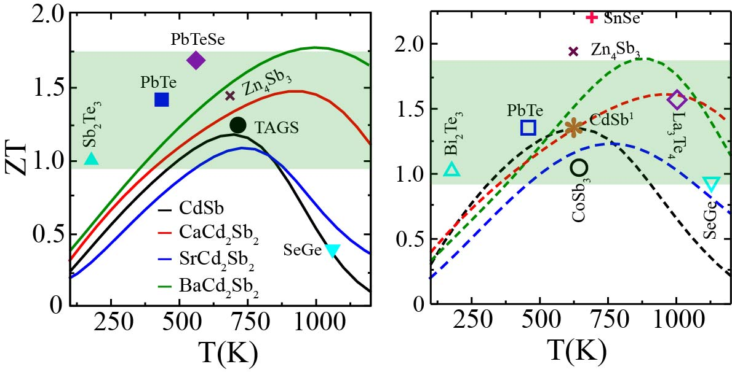
Indian Institute of Science, Bangalore
Figure of merit
p-type
n-type
Nature Materials 7, 105 - 114 (2008)
1 Chem. Mater., 2015, 27 (3)
Large anharmonicity leads to high ZT (1.9)
Comparable to the other state of the art Zintl thermoelectric materials
Phys. Chem. Chem. Phys.17, 16917 (2015)

Slide 17
Indian Institute of Science, Bangalore
Conclusions
Heavy and light combination of bands leads to large power factor
Strong anharmonicity results in low thermal conductivity
By changing cation layer thermal conductivity can be reduced
ZT is comparable to best know thermoelectrics
Phys. Chem. Chem. Phys.17, 16917 (2015)

Slide 18
Indian Institute of Science, Bangalore
Breaking the inverse coupled dependence of S and σ

Slide 19
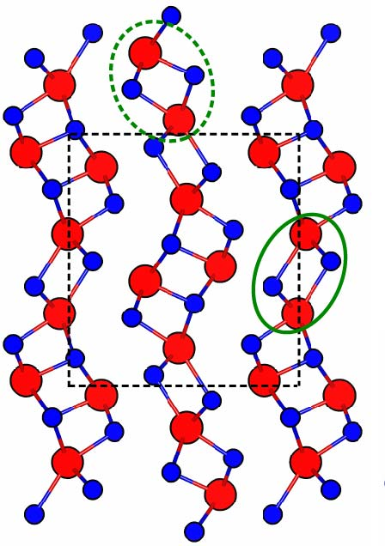
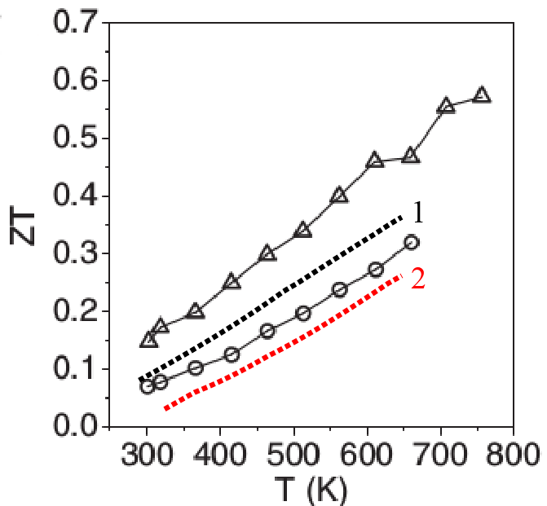
Indian Institute of Science, Bangalore
Bi₂S₃: Possible good thermoelectric material
Current scenario for Bi₂S₃
Moderate 1.23 eV band gap semiconductor
Large thermopower and low thermal conductivity
Poor electrical conductivity
Data from: Adv. Energy Mater. 2012, 2, 634–638
1. Solid State Communications 162 (2013) 48–52
2. Journal of Alloys and Compounds 514 (2012) 205– 209
Pressure can be used to improve σ
For Bi₂Te₃: ZT ~ 1.5

Slide 20
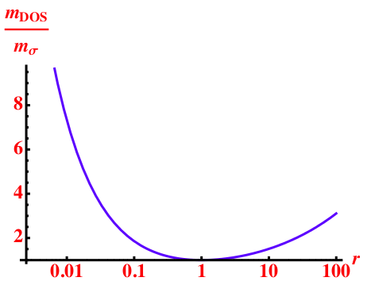
Indian Institute of Science, Bangalore
How pressure can tune thermoelectric properties?
Condition for high S and σ
At a fixed T and carrier conc. (n)
$$σ= \frac{ne^{2}τ}{m_{cond}^{∗}}$$
$$S\left(T\right)∝m_{dos}^{∗}n^{−\frac{2}{3}}$$
Density of states effective mass
Conductivity effective mass
$$m_{dos}^{∗}=γ^{\frac{2}{3}}{\left(m_{∥}^{2}m_{⊥}\right)}^{\frac{1}{3}}$$
$$m_{cond}^{∗}= \frac{3m_{∥}m_{⊥}}{2m_{⊥}+m_{∥}}$$
$$\frac{m_{dos}^{∗}}{m_{cond}^{∗}}$$
$$\frac{m_{dos}^{∗}}{m_{cond}^{∗}}=\frac{2}{3}r^{\frac{1}{3}}+\frac{1}{3}r^{−\frac{2}{3}}$$
$$r=\frac{m\text{⊥}}{m||}$$
High density of states effective mass (m*_{dos})
Low conductivity effective mass (m*_{cond})
Phys. Rev. Applied 3.064003

Slide 21
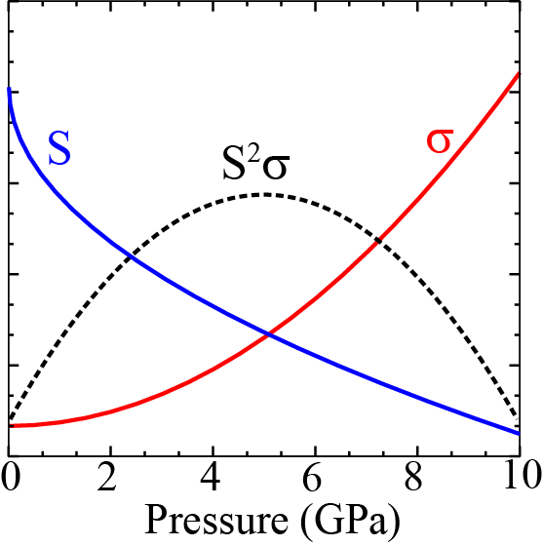
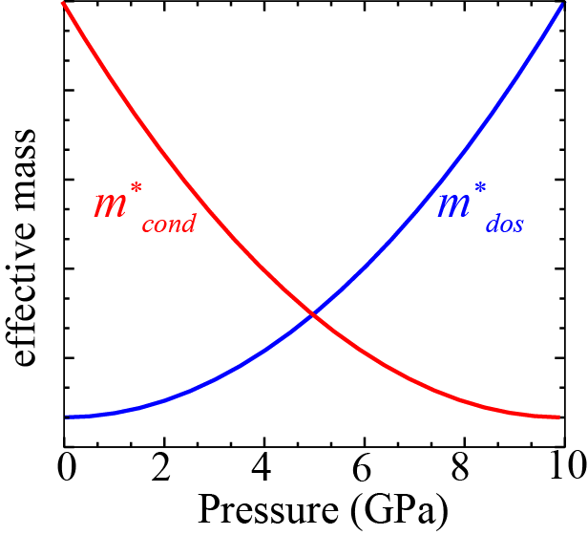
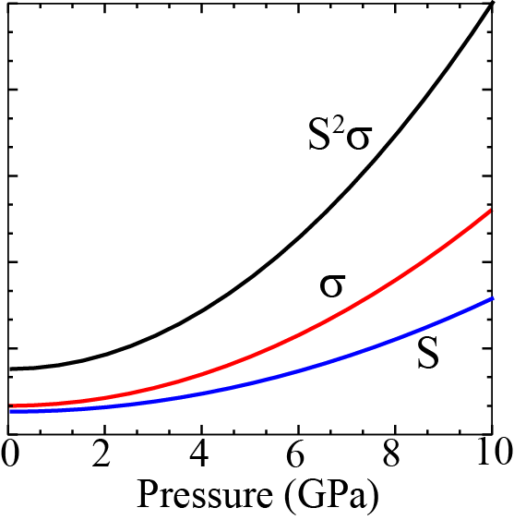
Indian Institute of Science, Bangalore
How pressure can tune thermoelectric properties?
Tuning of band gap and band dispersion
Due to reduction in either S or σ, pressure induced tuning is not very significant
Careful band structure engineering can lead to high ZT
J. Mater. Chem. C, 4, 1979 (2016)
Notes:
The first figure denotes the inverse coupled dependence of S and sigma with pressure. As S increases sigma starts to decrease. The opposite is also true. hence although the enhancement is observed but it is not very significant. The second figure shows the condition for simultaneous enhancement of S and sigma. If band structure can be tuned in such a way that m_cond decreases with pressure and m_dos increases with pressure this will lead to Simultaneous enhancement in S and sigma leading to huge power factora as shown in figure 3. this is what we have shown for Bi2S3.

Slide 22
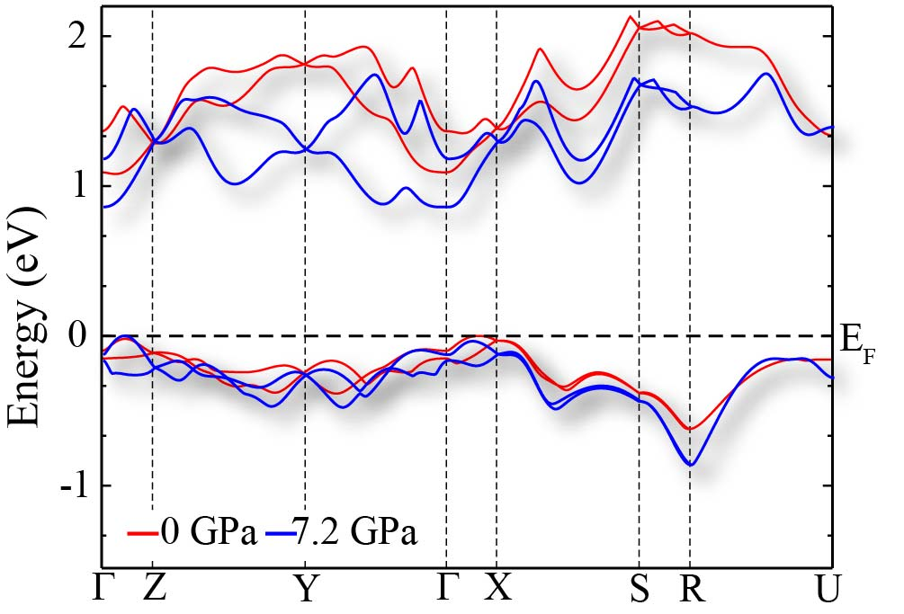
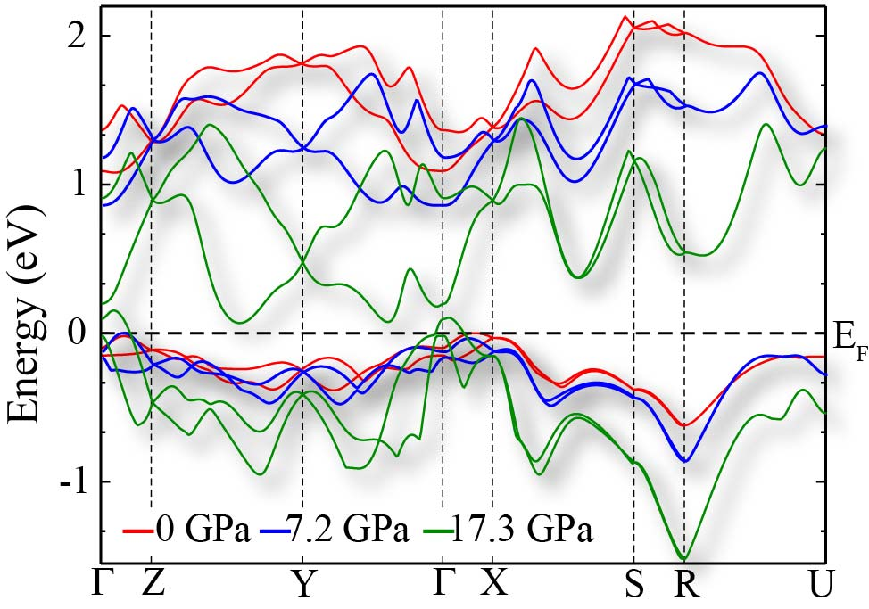
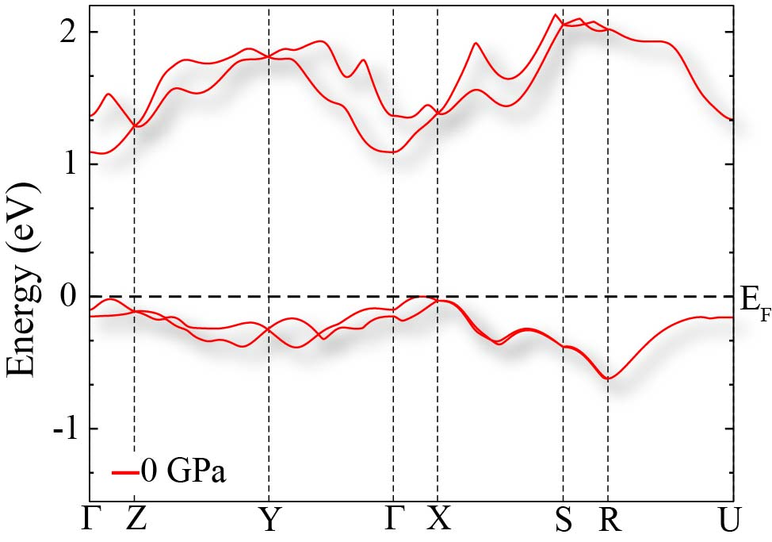
Electronic structure under pressure
Indian Institute of Science, Bangalore
Hydrostatic pressure significantly modifies the conduction band
Compression indicates anisotropy in crystal structure
Semi conductor to metal transition at 17.3 GPa
J. Mater. Chem. C, 4, 1979 (2016)

Slide 23
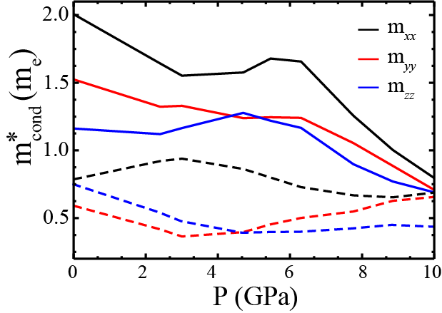
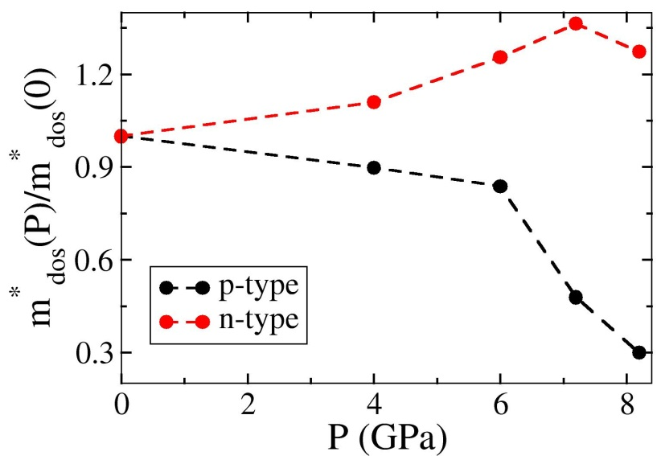
Carrier effective mass
Indian Institute of Science, Bangalore
m*_{cond} decreases with pressure
m*_{dos} increases with pressure for n-type
J. Mater. Chem. C, 4, 1979 (2016)

Slide 24
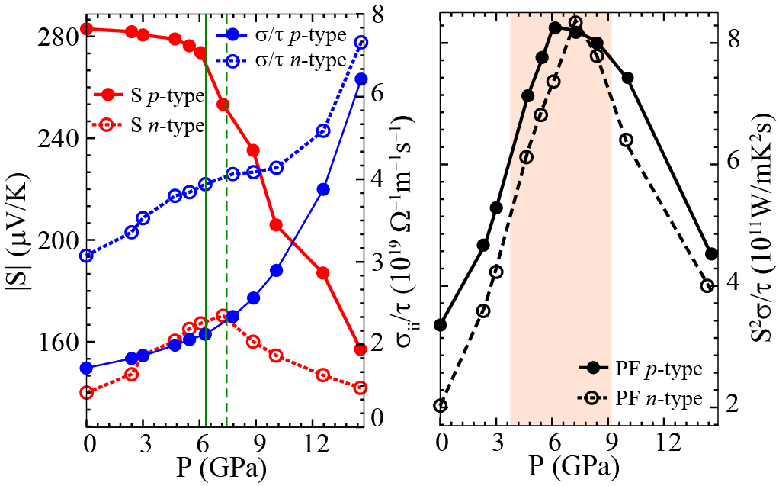
Transport properties under pressure
Indian Institute of Science, Bangalore
Simultaneous enhancement of S and σ under pressure for n-type doping
Five fold enhancement in power factor under pressure
J. Mater. Chem. C, 4, 1979 (2016)

Slide 25
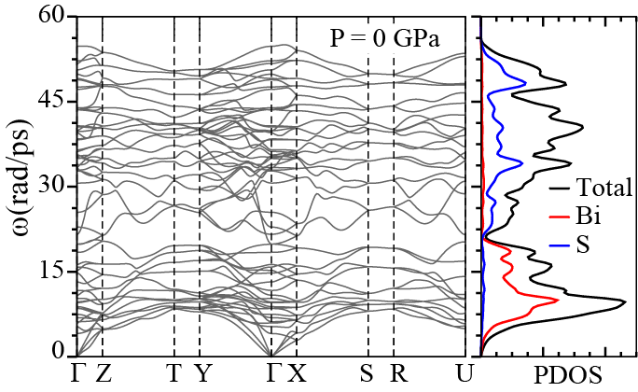
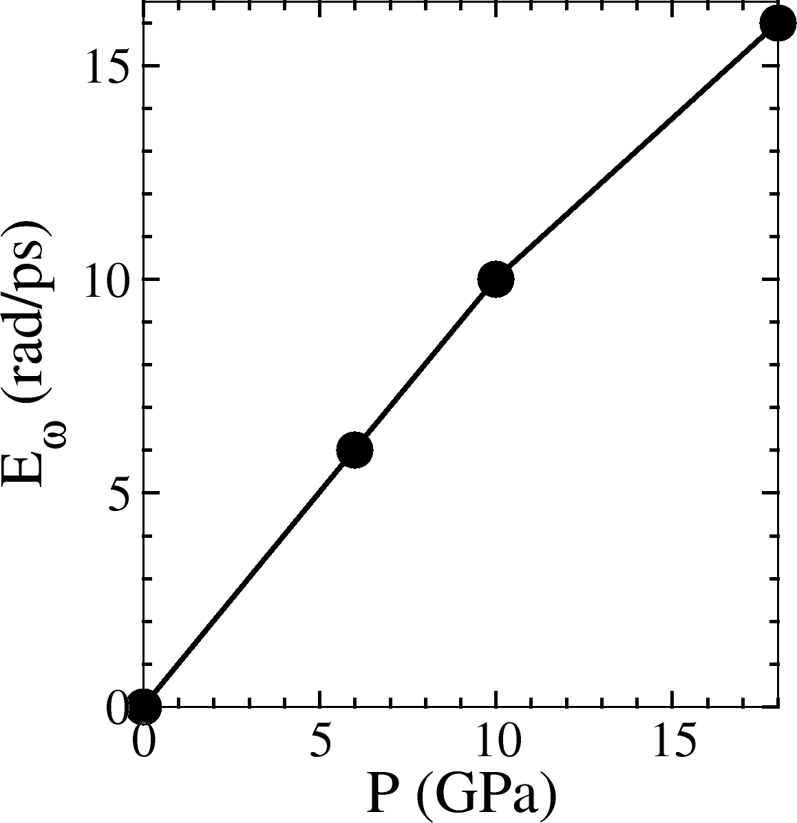
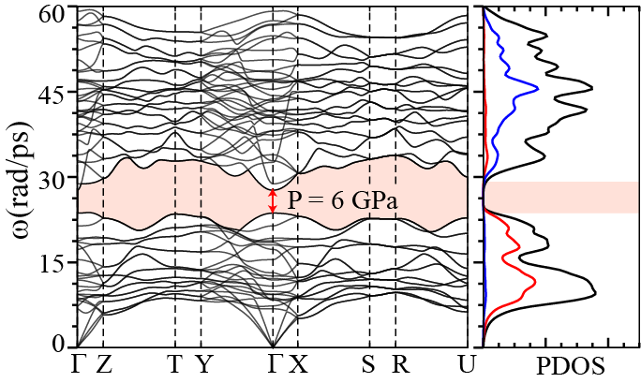
Effect of pressure on thermal transport
Indian Institute of Science, Bangalore
According to Liebfried and Schlömann theory $\frac{dk}{dp}>0$
Very low lying optical modes
Strong overlap between acoustic and optical phonons
Optical modes split under pressure
J. Mater. Chem. C, 4, 1979 (2016)

Slide 26
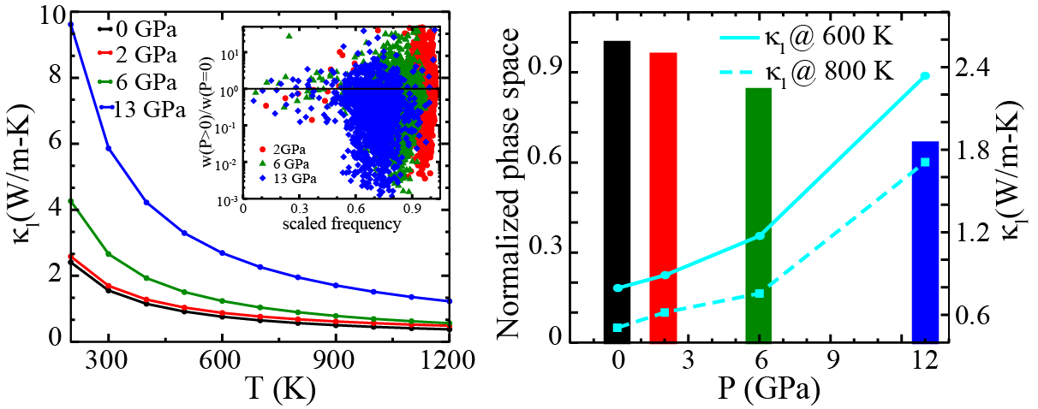
Thermal conductivity under pressure
Indian Institute of Science, Bangalore
Nominal change in thermal conductivity in the pressure range of interest
(P ≤ 0 ≤ 7.5 Gpa)
J. Mater. Chem. C, 4, 1979 (2016)

Slide 27
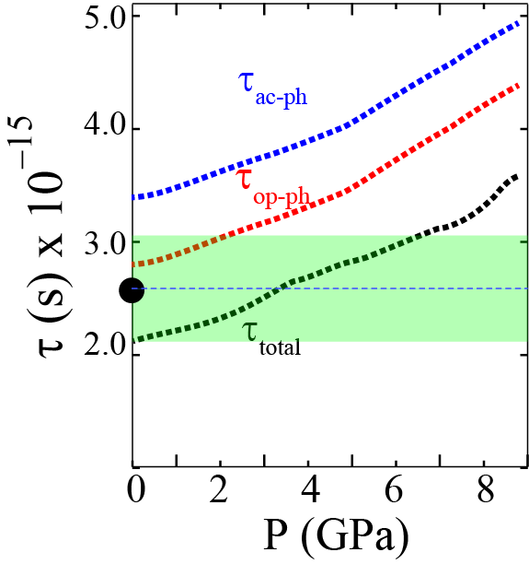
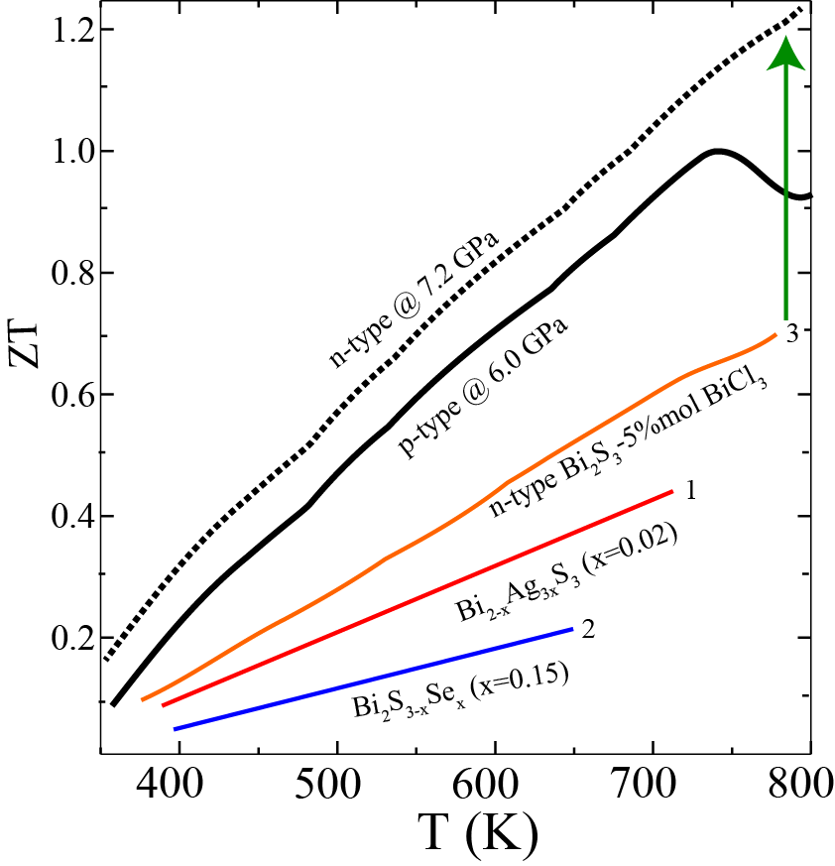
Figure of merit
Indian Institute of Science, Bangalore
Very small change in relaxation time
ZT ~ 1.2 for n-doped Bi₂S₃
ZT ~ 1.0 for p-doped Bi₂S₃
J. Mater. Chem. C, 4, 1979 (2016)
Notes:
Deformation potential theory black dot sigma/tau compare it with the experimeent

Slide 28
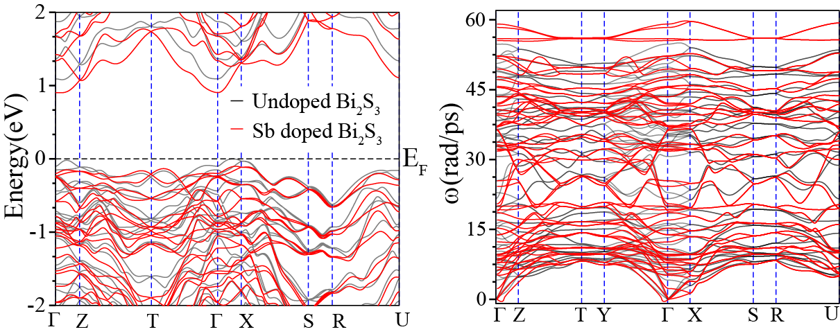
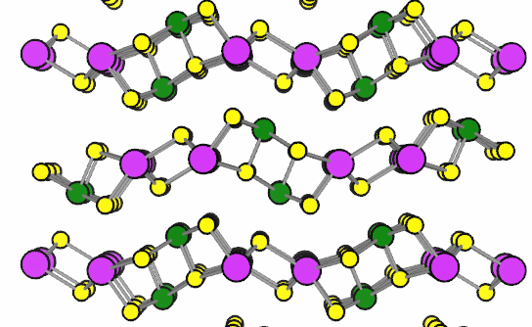
Effect of equivalent chemical pressure introduced by doping
Bi
Sb
S
Doping results in 3 GPa chemical pressure
Band gap reduces upon Sb doping
Softening of phonon modes upon doping
J. Mater. Chem. C. 4, 1979-1987 (2016)

Slide 29
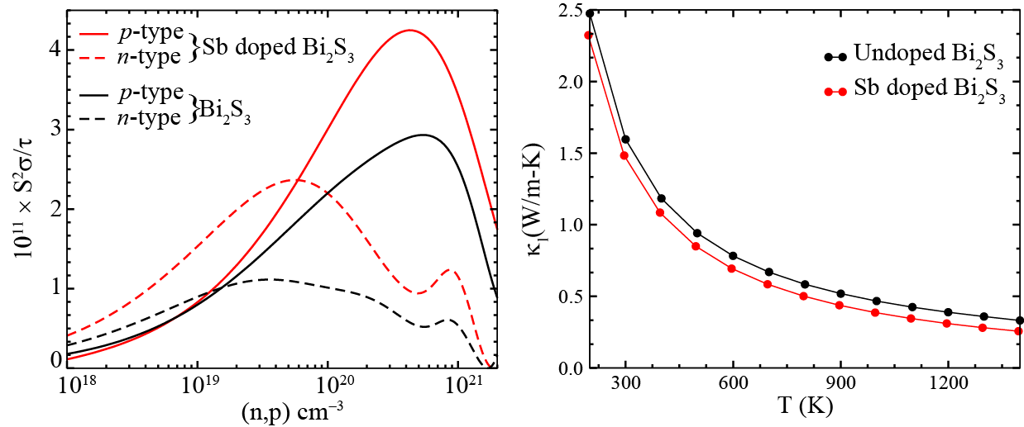
Effect of equivalent chemical pressure introduced by doping
Enhancement in power factor upon doping
Reduction in lattice thermal conductivity upon doping
J. Mater. Chem. C. 4, 1979-1987 (2016)

Slide 30
Conclusions
Reversible tuning of band gap of Bi₂S₃ using hydrostatic pressure semiconductor to metal transition at 17.2 GPa
m*_{cond} decreases and m*_{dos} increases with pressure for n-type
Weak dependence of thermopower at low pressures for p-doped Bi₂S₃
Simultaneous enhancement of S and σ for n-doped Bi₂S₃
Thermal conductivity shows nominal increase at low pressures
Large ZT of 1.2 and 1.0 for n and p-doped Bi₂S₃, respectively

Slide 31
Future direction
Indian Institute of Science, Bangalore
High throughput screening of thermoelectric materials
Phys. Rev. B 92, 085205 (2015)
Band Engineering in Semiconductor
From lab to industry
PRL 114, 136601 (2015)
The Electrochemical Society Interface • Fall 2008

Slide 32
Before and after SahasraT

Slide 33
Publications using SahasraT
11 publications after the establishment of SahasraT

Slide 34
Happy birthday SahasraT!

Slide 35
Thank You

